Slide 1
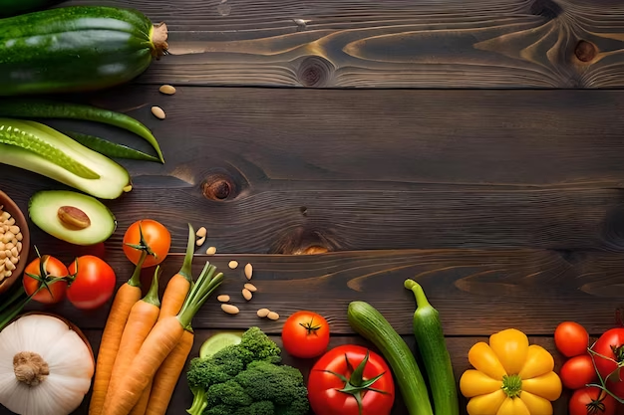
FRUITS AND VEGETABLES
A TSSC Health Coaching Module

Slide 2
Let's talk about how things have been
since the last time we met
Notes:
PROMOTORA

Slide 3
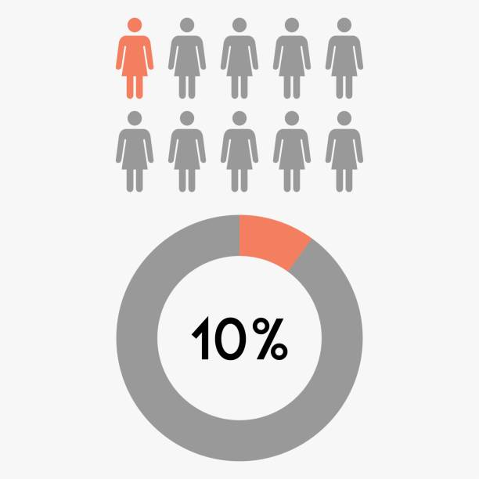
¿How many fruits and vegetables are we consuming?
9 out of 10 Americans are NOT consuming the recommended portions of fruits and vegetables.
Notes:
Depending on their age and sex federal guidelines recommend that adults eat at least 1½ to 2 cups per day of fruitexternal icon and 2 to 3 cups per day of vegetablesexternal icon as part of a healthy eating pattern.
“This report highlights that very few Americans eat the recommended amount of fruits and vegetables every day, putting them at risk for chronic diseases like diabetes and heart disease,”

Slide 4
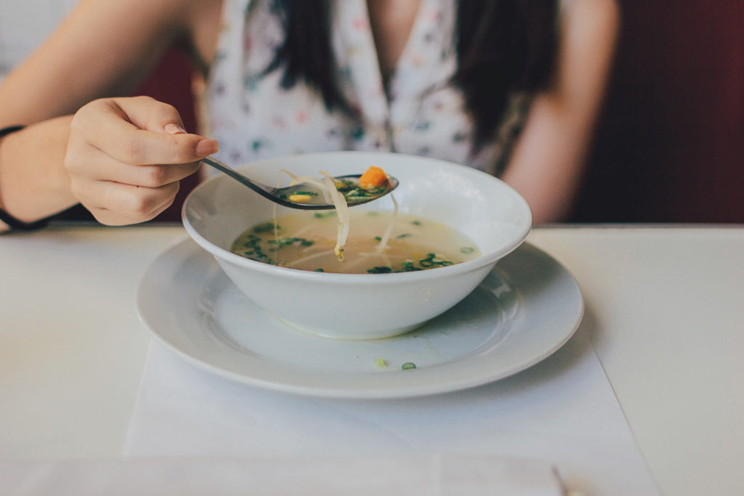
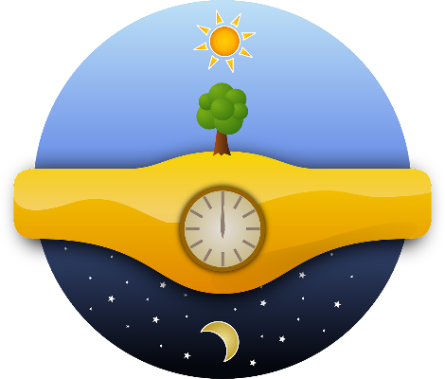
How many fruits and vegetables am I consuming daily?
Think about the food you normally eat and how many servings of fruits and vegetables it includes?
Some examples:
Breakfast
Lunch
Dinner
Smoothie
Eggs
Tacos
Pancakes
Juice
Soup
Rice
Tacos
With chicken
With meat
Snack
Pizza
Tacos
Stew
Snacks
Notes:
ACTIVIDAD
Entregar una hoja de trabajo para que cada persona piense en sus comidas habituales y saque una idea de cuantas de sus comidas incluyen frutas y verduras en relacion al tamano de una porcion con medida de 1 taza.

Slide 5
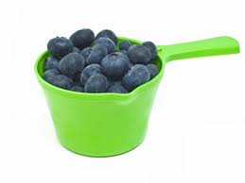
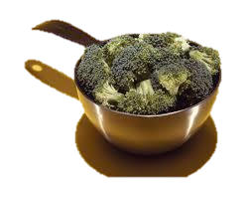
What is a portion?
1 SERVING OF FRUITS
1 cup of raw or cooked fruits
1 cup of 100% fruit juice
½ cup dried fruit
1 SERVING OF VEGETABLES
1 cup of raw or cooked vegetables
1 cup of 100% natural vegetable juice
2 cups of salad greens
Notes:
Hacer demostracion ensenando una taza
Una porción es la cantidad de alimento que decides comer en determinado momento, bien sea en un restaurante, de un paquete o en su casa. Es importante poner atencion a las medidas de nuestras porciones de los alimentos y bebidas que hacemos, particiularmente con los que no son densos en nutrientes.

Slide 6
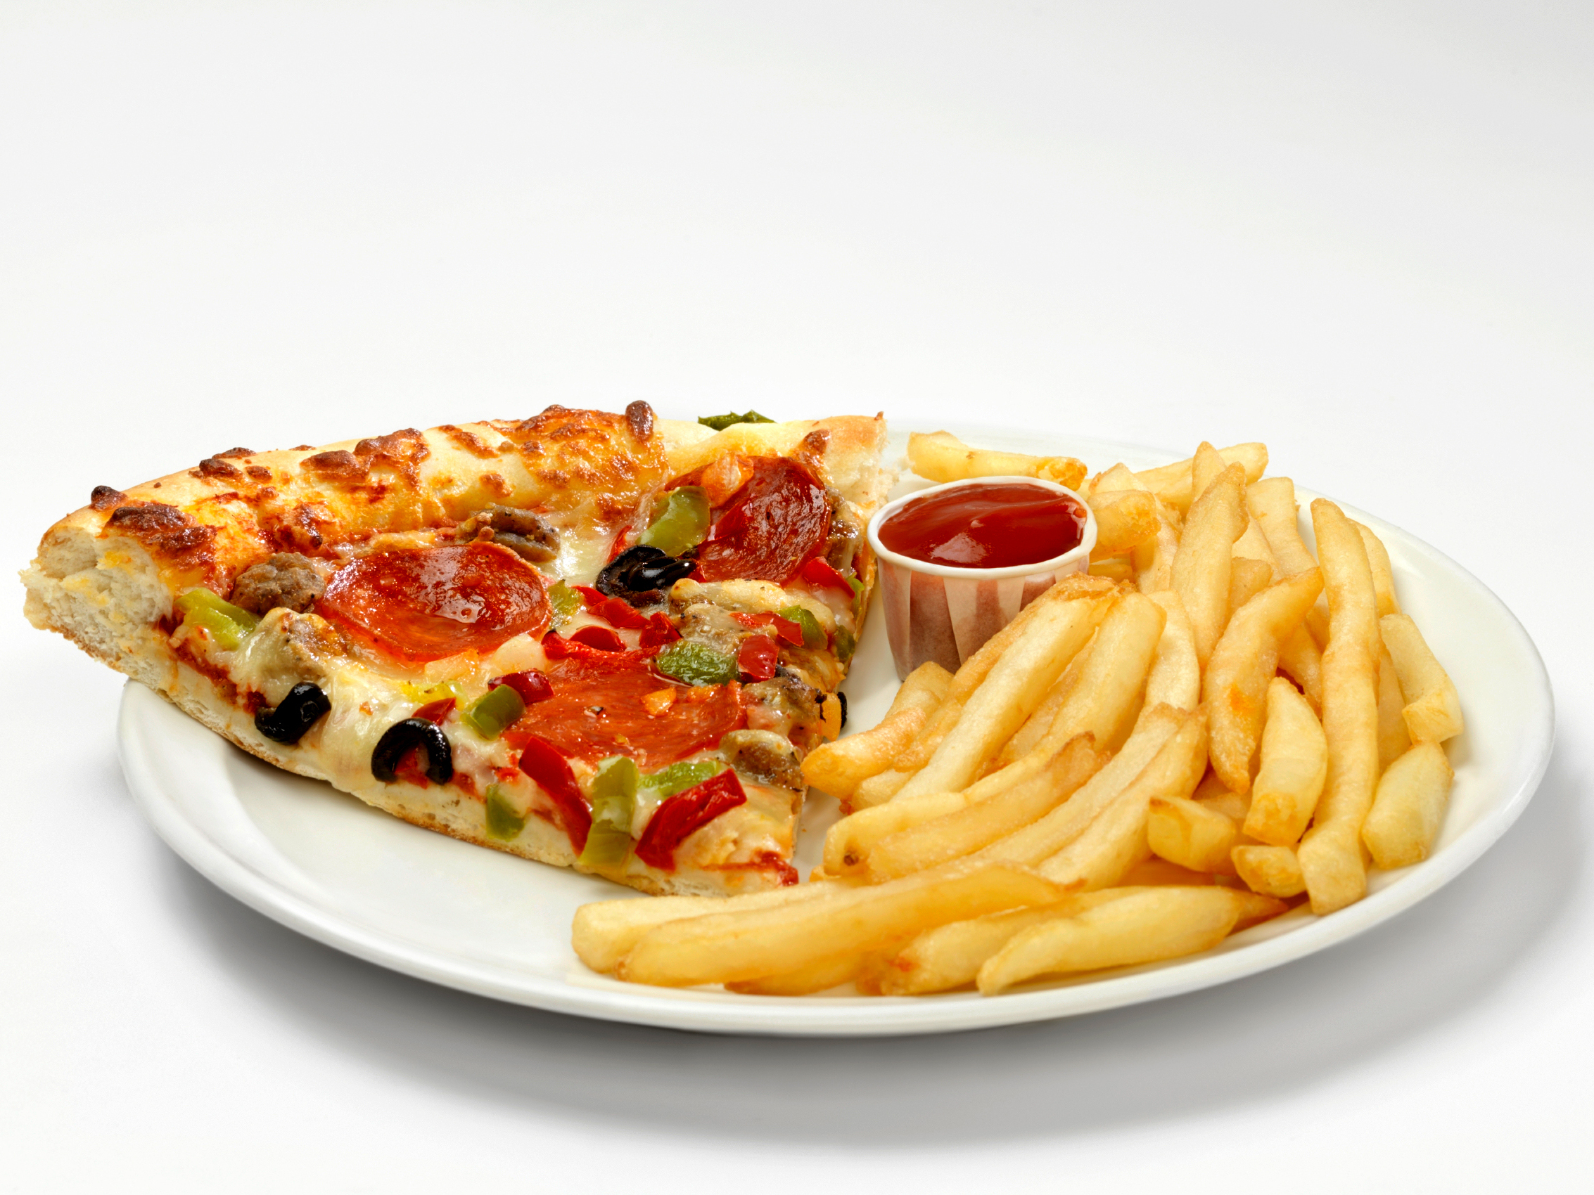
What would 5 cups of fruits and vegetables look like?
Notes:
Los estadounidenses comen 1.5 tazas de verduras al día, en promedio, según el USDA. Pero la guia nacionales de nutrición recomiendan de 2 a 3 tazas al día para los adultos.
Y más de la mitad de nuestra ingesta de verduras proviene de papas y tomates, mientras que solo el 10 por ciento proviene de verduras de color verde oscuro y naranja como espinacas, zanahorias y papas.

Slide 7
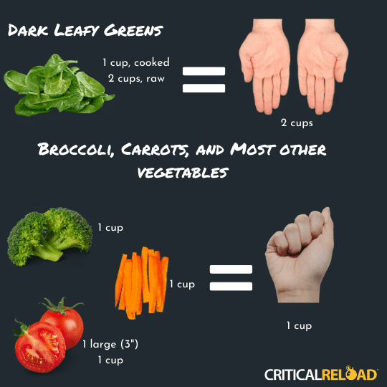
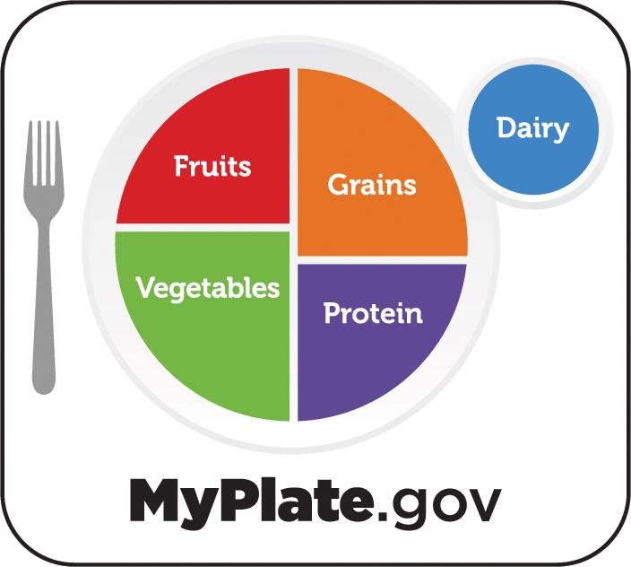
3 types of tools to help you know if what you are consuming counts as an added nutrition
Hands Cups ½ of your plate
Notes:
• Grains, especially whole grains, are recognized as an essential for good health.
• Whole grains are nutrient-rich, providing many key nutrients – vital for the health and maintenance of our bodies.
• Beyond good nutrition, whole grains are tasty, satisfying (leave you feeling more full, along with protein), convenient, and easy to prepare.
• Add an array of colors to your plate and think of it as eating the rainbow.
• Dark, leafy greens, oranges, and tomatoes—even fresh herbs—are loaded with vitamins, fiber, and minerals.
• Adding frozen peppers, broccoli, or onions to stews and omelets gives them a quick and convenient boost of color and nutrients.
• Fresh, frozen, or canned fruits are great choices.
• Try fruits beyond apples and bananas such as mango, pineapple or kiwi fruit.
• When fresh fruit is not in season, try a frozen, canned, or dried variety.
• Be aware that dried and canned fruit may contain added sugars or syrups.
• Choose canned varieties of fruit packed in water or in its own juice.
• In addition to fat-free and low-fat milk, consider low-fat and fat-free yogurts without added sugars.
• These come in a variety of flavors and can be a great dessert substitute.
• If your favorite recipe calls for frying fish or breaded chicken, try healthier variations by baking or grilling.
• Add many different types of beans (black, kidney, pinto, for examples) to your soups, salads and pasta dishes.
• Try sprinkling unsalted, dry-roasted nuts over your salads.
• Fats provide structure for your body and store energy.
• Make most of your fat sources from fish, nuts, and vegetable oils.
• Limit butter, margarine, shortening and lard.
• You can still enjoy your favorite foods, even if they are high in calories, fat or added sugars. The key is eating them only once in a while.
Citation:
https://www.cdc.gov/healthyweight/healthy_eating/index.html
https://www.heart.org/-/media/files/health-topics/answers-by-heart/how-do-i-follow-a-healthy-diet.pdf

Slide 8
Based on what we just learned…
Considering that one portion is equivalent to this image…
How many portions of fruit would you say you eat daily?
Considering that one portion is equivalent to this image…
How many portions of vegetables do you eat daily?
Notes:
Hasta ahorita hemos aprendido
que cuenta como 1 porcion recomendada
Hemos hecho conciencia de nuestros habitos propios e identificado nuestro consume actual
Ahora saquemos cuentas de los dos datos y contestemos la siguiente pregunta
Basado en el tamaño de esta imagen, ¿cuantas porciones de fruta come usted en un dia normal? ___________________
Basado en el tamaño de esta imagen, ¿cuantas porciones de verduras come usted en un día normal?)_______________

Slide 9
Activity
Notes:
ACTIVIDAD
Entregar una hoja de trabajo para que cada persona piense en sus comidas habituales y saque una idea de cuantas de sus comidas incluyen frutas y verduras en relacion al tamano de una porcion con medida de 1 taza.

Slide 10
RECOMMENDED DAILY PORTION EXAMPLES
​
https://www.myplate.gov/es/myplate-plan
Notes:
• Grains, especially whole grains, are recognized as an essential for good health.
• Whole grains are nutrient-rich, providing many key nutrients – vital for the health and maintenance of our bodies.
• Beyond good nutrition, whole grains are tasty, satisfying (leave you feeling more full, along with protein), convenient, and easy to prepare.
• Add an array of colors to your plate and think of it as eating the rainbow.
• Dark, leafy greens, oranges, and tomatoes—even fresh herbs—are loaded with vitamins, fiber, and minerals.
• Adding frozen peppers, broccoli, or onions to stews and omelets gives them a quick and convenient boost of color and nutrients.
• Fresh, frozen, or canned fruits are great choices.
• Try fruits beyond apples and bananas such as mango, pineapple or kiwi fruit.
• When fresh fruit is not in season, try a frozen, canned, or dried variety.
• Be aware that dried and canned fruit may contain added sugars or syrups.
• Choose canned varieties of fruit packed in water or in its own juice.
• In addition to fat-free and low-fat milk, consider low-fat and fat-free yogurts without added sugars.
• These come in a variety of flavors and can be a great dessert substitute.
• If your favorite recipe calls for frying fish or breaded chicken, try healthier variations by baking or grilling.
• Add many different types of beans (black, kidney, pinto, for examples) to your soups, salads and pasta dishes.
• Try sprinkling unsalted, dry-roasted nuts over your salads.
• Fats provide structure for your body and store energy.
• Make most of your fat sources from fish, nuts, and vegetable oils.
• Limit butter, margarine, shortening and lard.
• You can still enjoy your favorite foods, even if they are high in calories, fat or added sugars. The key is eating them only once in a while.
Citation:
https://www.cdc.gov/healthyweight/healthy_eating/index.html
https://www.heart.org/-/media/files/health-topics/answers-by-heart/how-do-i-follow-a-healthy-diet.pdf

Slide 11
Community Success Stories!
Role Model in Spsnish https://vimeo.com/505852089 Newsletter Span- Role model story https://vimeo.com/519347112 Recetas Tu Salud Si Cuenta - Hamburguesa de Pavo on Vimeo Tu Salud Si Cuenta - Ensalada Mediterránea con Quinoa on Vimeo Tu Salud Si Cuenta - Liquado de Sandia on Vimeo
Role Model spanish
Recetas
Notes:
¿Cómo te identificas con esta historia?
¿De qué manera la historia de Maggie es diferente a la tuya en cuanto a los obstáculos que tendrías que afrontar si decides hacer un cambio en tu alimentación?
¿Qué motivaciones y limitantes consideras que tienes tú para lograr hacer un cambio como el de esta historia?

Slide 12
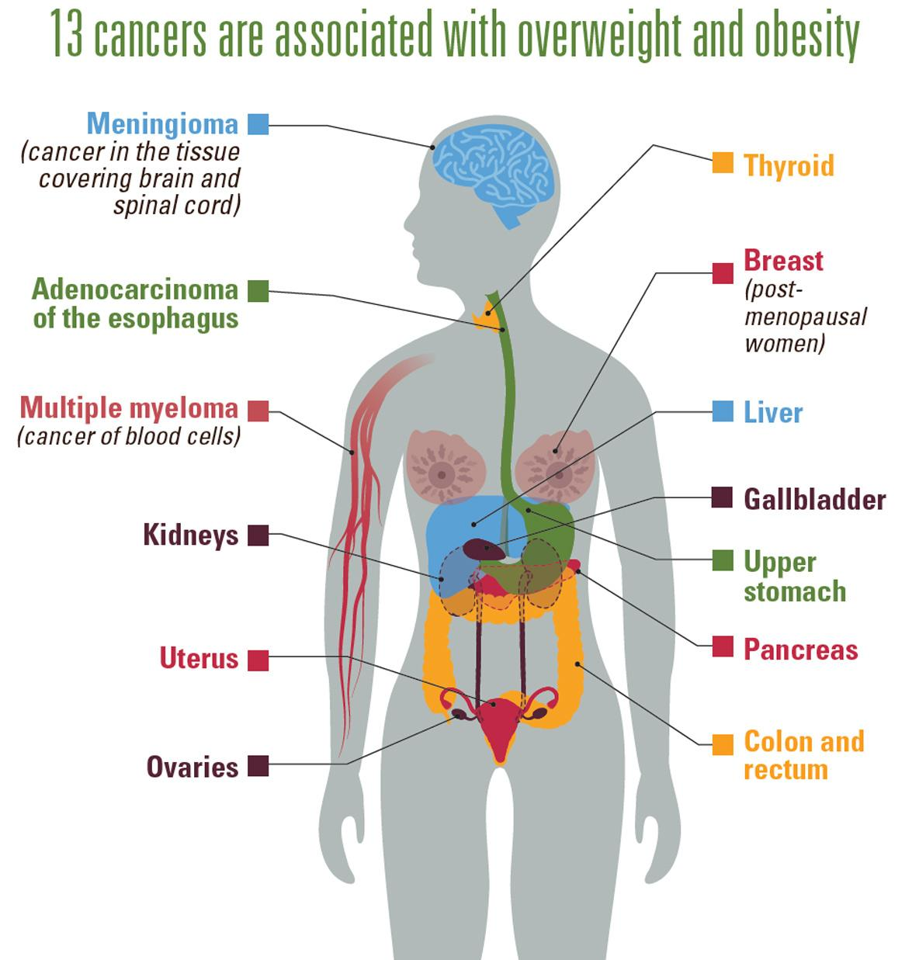
Healthy eating helps you avoid:
Type 2 Diabetes
Hypertension
Obesity
Cancer
Heart failure
Cardionascular conditions
Negative Health Effects of a Nutrient-Deficient Diet
Notes:
EFECTOS NEGATIVOS DE
UN PATRON ALIMENTICIO POBRE EN NUTRIENTES
Source:
https://www.cdc.gov/chronicdisease/resources/publications/factsheets/nutrition.htm
Overweight and Obesity
Eating a healthy diet, along with getting enough physical activity and sleep, can help children grow up healthy and prevent overweight and obesity. In the United States, 20% of young people aged 2 to 19 years and 42% of adults have obesity, which can put them at risk of heart disease, type 2 diabetes, and some cancers.
Heart Disease and Stroke
Two of the leading causes of heart disease and stroke are high blood pressure and high blood cholesterol. Consuming too much sodium can increase blood pressure and the risk for heart disease and stroke. Current guidelines recommend getting less than 2,300 mg a day, but Americans consume more than 3,400 mg a day on average.
Over 70% of the sodium that Americans eat comes from packaged, processed, store-bought, and restaurant foods. Eating foods low in saturated fats and high in fiber and increasing access to low-sodium foods, along with regular physical activity, can help prevent high blood cholesterol and high blood pressure.
Type 2 Diabetes
People who are overweight or have obesity are at increased risk of type 2 diabetes compared to those at a healthybecause, over time, their bodies become less able to use the insulin they make. Of US adults, 96 million—more than 1 in 3—have prediabetes, and more than 8 in 10 of them don’t know they have it. Although the rate of new cases has decreased in recent years, the number of adults with diagnosed diabetes has nearly doubled in the last 2 decades as the US population has increased, aged, and become more overweight.
Cancer
An unhealthy diet can increase the risk of some cancers. Consuming unhealthy food and beverages, such as sugar-sweetened beverages and highly processed food, can lead to weight gain, obesity and other chronic conditions that put people at higher risk of at least 13 types of cancer, including endometrial (uterine) cancer, breast cancer in postmenopausal women, and colorectal cancer. The risk of colorectal cancer is also associated with eating red and processed meat.

Slide 13
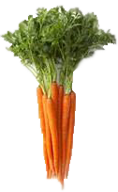
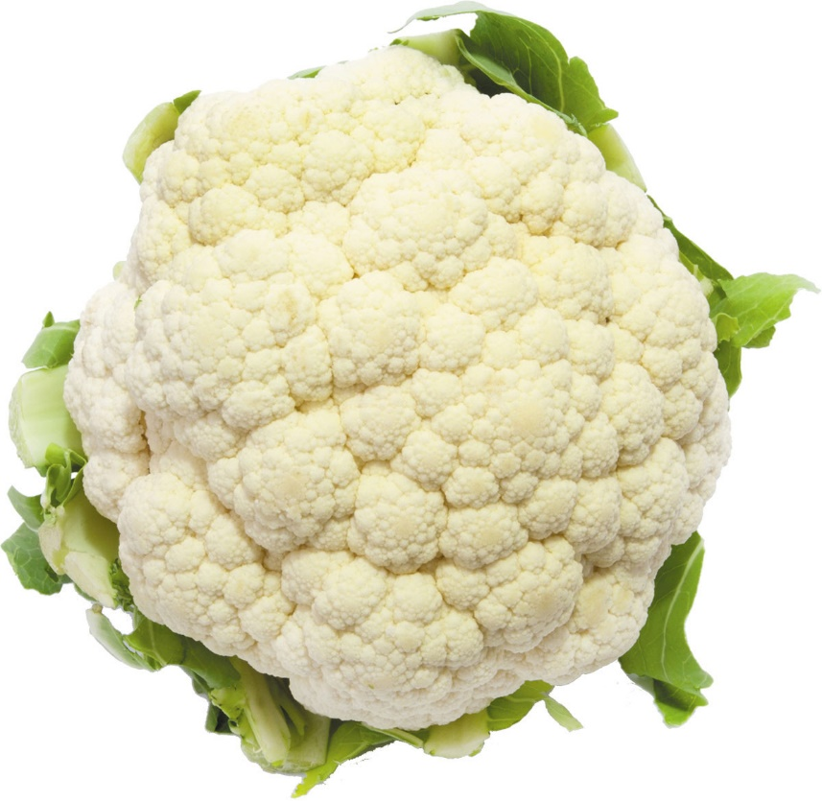
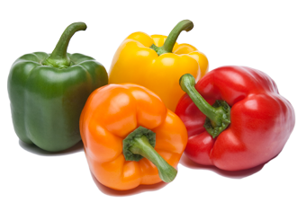
VITAMINA A
BENEFITS
Helps maintain eye and skin health
Helps protect against infections
VITAMIN A
Helps heal cuts and wounds
Helps keep teeth and gums healthy
VITAMINA C
Notes:
Fruits and vegetables high in Vitamin A include: carrots, dark leafy greens like kale and romaine lettuce, squash, cantaloupe, and mango

Slide 14
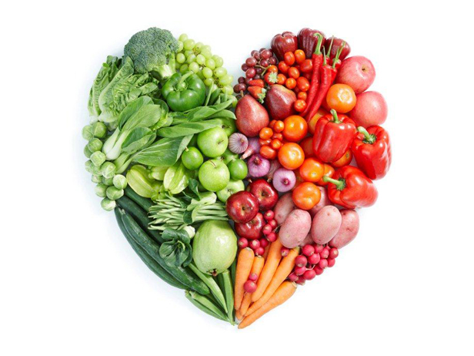
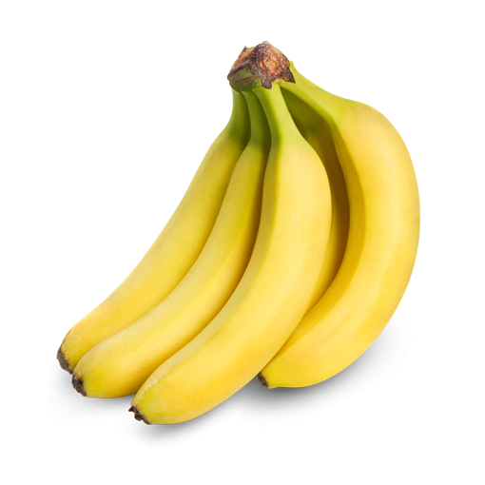
FIBRA
BENEFITS
Helps in digestion and prevents constipation
Helps reduce the risk of heart problems
FIBER
Helps maintain healthy blood pressure
Helps strengthen our muscles
POTASSIUM
Notes:
Fiber helps your digestive tract function properly and may reduce the risk of heart disease.
Fruits and vegetables high in fiber include:
Raspberries
Pear, with skin
Apple, with skin
Bananas
Artichoke
Green peas
Brocolli

Slide 15
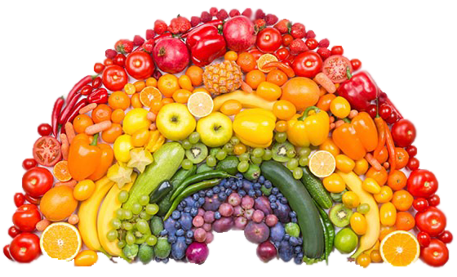
VARIETY
To get the full benefits of fruits and vegetables, you should eat a combination of colors from different groups.
Take CONTROL by including a variety of nutrient-dense foods as ​helps you prevent diseases!

Slide 16
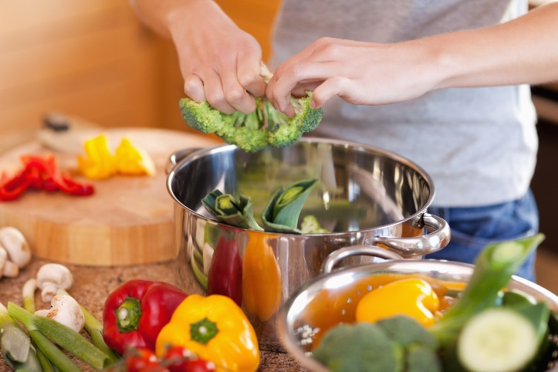
“Cooking with fruits and vegetables takes a long time!”
TRUE
FALSE
Notes:
Cocina una cena saludable solo una vez a la semana, ese es un gran primer paso. Trate de cocinar las comidas en lotes el fin de semana para calentar para las cenas durante la semana.

Slide 17
FALSE
TIPS:
Cut the fruit and vegetables beforehand so you can have them ready when you are ready to cook.
Cook frozen vegetables if you are in a hurry.
Incorporate raw vegetables as a snack. The majority of these are very good in taste.
Notes:
Cocina una cena saludable solo una vez a la semana, ese es un gran primer paso. Trate de cocinar las comidas en lotes el fin de semana para calentar para las cenas durante la semana.

Slide 18
“I need to be a chef to cook fruits
and vegetables!”
TRUE
FALSE

Slide 19
FALSe
There are simple ways to add vegetables to our food.
Look for new recipes.
Try to add vegetables to favorite foods at home.

Slide 20
What are some SOLUTIONS you may have to these BARARRIERS?
“I cannot afford buying healthy food”
“My children do not like to eat healthy”
“I don’t like the majority of vegetables”

Slide 21
Behavior Change Importance Ruler
0
1
2
3
4
5
6
7
8
9
10
Not important at all
Somewhat important
Very important
Importance Scale
On a scale 0-10, How important is it for you to eat fruits and vegetables?
Notes:
ROLE PLAY
On this scale, with 1 being not at all important to consume more fruits and vegetables, and 5 being very important to consume more fruits and vegetables, which point best reflects how important it is to you to change nutritional habits?
Why did you say a ___ (the number they chose) and not a ___ (high number than given)?
What would it take for you to become a ___ (higher number than given)?
It might need to be done several times before action plan is developed.

Slide 22
TAKE CONTROL
FOCUS ON YOUR ACTIONS
OBJECTIVE
Starting today and until our next sesion, my goal is…
ACTION PLAN
✓ What are you going to do
✓ Why ✓ Where ✓ When ✓ For how long
What barriers can you run into? How will you manage these?
Notes:
Reducido: alimentos procesados Al crear su plan de acción, es importante saber lo siguiente: ✓ Qué harás ✓ Dónde lo harás ✓ Cuándo lo harás ✓ Cuánto tiempo lo harás Establecer metas puede ser el primer paso para crear su plan de acción para controlar su presión arterial. Un posible objetivo podría ser medir su presión arterial dos veces al día entre ahora y la próxima cita con su proveedor de atención médica. Para lograr ese objetivo, puede obtener lecturas de la presión arterial una vez por la mañana y una vez por la noche. Al crear sus metas, tenga en cuenta qué desafíos podría enfrentar y cómo los superaría. ¿Cuál podría ser su objetivo personal para controlar su presión arterial?

Slide 23
ACTION PLAN
My GOAL is:_______________________________________________________________________________________________
Why will I do it?
How will I do it?
When will I do it?
Challenges I might face?
Ways to meet the challenges?
What benefits will I get?
Notes:
As you fill out your meal plan, think about the following:
Why you want to make healthier changes in your food patterns.
What motivates you to make changes that might not be easy but are worth doing for a better health.
Think about what barriers you may encounter and what solutions you have
Role Play an Example
Add one fruit or vegetable to every meal.
If you get fast food, ask for a salad instead of fries.
Commit to one salt-free day a week. Use herbs for flavor instead.
Keeping cut-up fruits and veggies on hand in the fridge for easy snacking.
Chose healthier takeout and fast-food options, like a grilled chicken sandwich instead of fried.

Slide 24
Are you ready to make a change?
0
1
2
3
4
5
6
7
8
9
10
Not ready at all
Somewhat ready
Very ready
Preparedness scale
On a scale from 0-10, how ready are you to start increasing fruit and vegetable consumption?
Notes:
ROLE PLAY
On this scale, with 1 being not at all important to consume more fruits and vegetables, and 5 being very important to consume more fruits and vegetables, which point best reflects how important it is to you to change nutritional habits?
Why did you say a ___ (the number they chose) and not a ___ (high number than given)?
What would it take for you to become a ___ (higher number than given)?
It might need to be done several times before action plan is developed.

Slide 25
Level of confidence to start making a change
0
1
2
3
4
5
6
7
8
9
10
Not confident
Somewhat confident
Not confident
Confidence scale
On a scale from 0-10, what is your confident increasing your fruits and vegetables portions?
Notes:
ROLE PLAY
On this scale, with 1 being not at all important to consume more fruits and vegetables, and 5 being very important to consume more fruits and vegetables, which point best reflects how important it is to you to change nutritional habits?
Why did you say a ___ (the number they chose) and not a ___ (high number than given)?
What would it take for you to become a ___ (higher number than given)?
It might need to be done several times before action plan is developed.

Slide 26
Brochures
Current consumption of fruits and vegetables My Plate-Plan Action Plan
Flyer

