Slide 1
IntroducTIOn
A Tu Salud ¡Sí Cuenta! Health Coaching Module
A TSSC Health Coaching Module

Slide 2
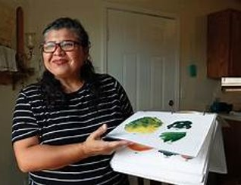
The Health of the CHW also matters!
My name is Marcelina Matinez!
My role and work in the community
What is Tu Salud Si Cuenta?
Why are we here today?
My goal is to support you
to make positive changes to
your life
I hope to provide you will the tools to help you make these changes.
Notes:
Al pensar en como tener una vida saludable, porque Mi Salud, Si Cuenta!...
Ejemplo:
Meta
" Comprar una verdura que nunca he probado y encontrar una receta para cocinarla esta semana."
Razon
No llegar a las mismas complicaciopnes de salud que mi familia ha tenido por la diabetes

Slide 3
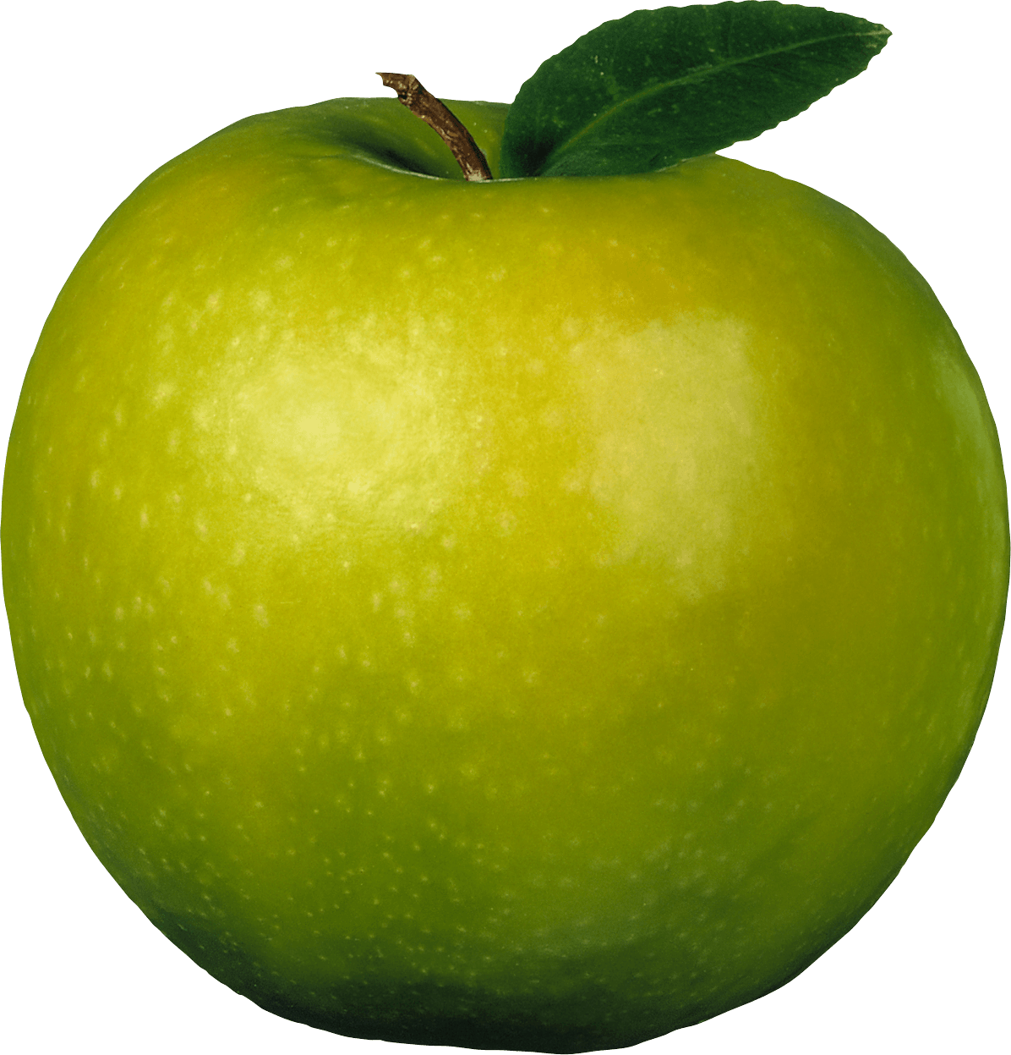
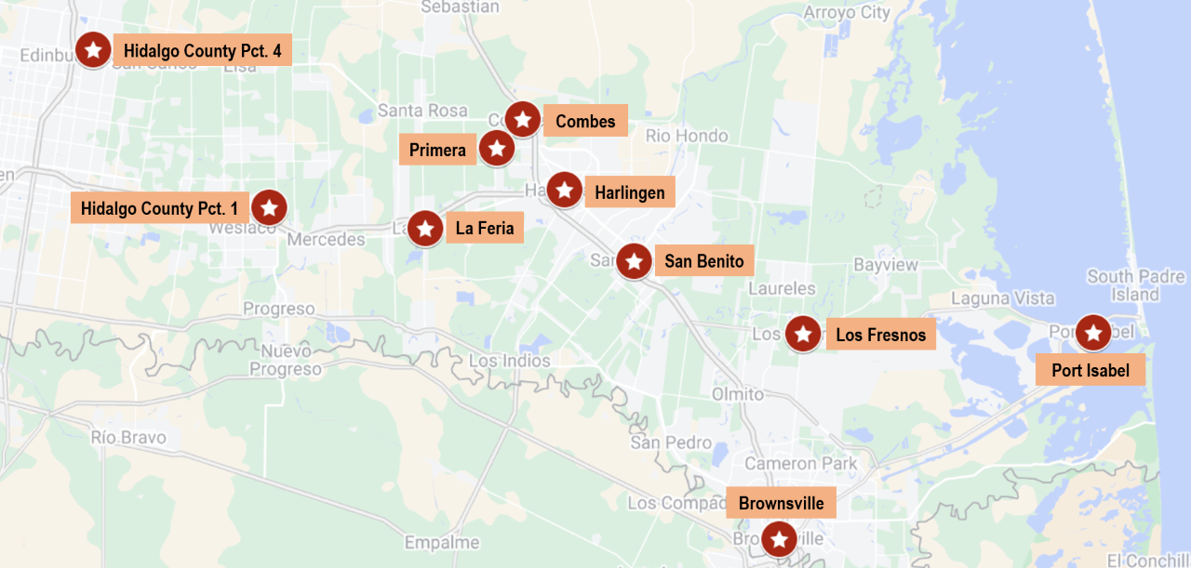
TSSC expanding...You can make change happen in your community!
Brooks County
Duval County
Willacy County

Slide 4
Did you know?
Hispanics in Cameron, Duval, Hidalgo, Willacy and Brooks counties experience a higher rate of cancer incidence and mortality when compared to the entire Hispanic population of Texas.

Slide 5
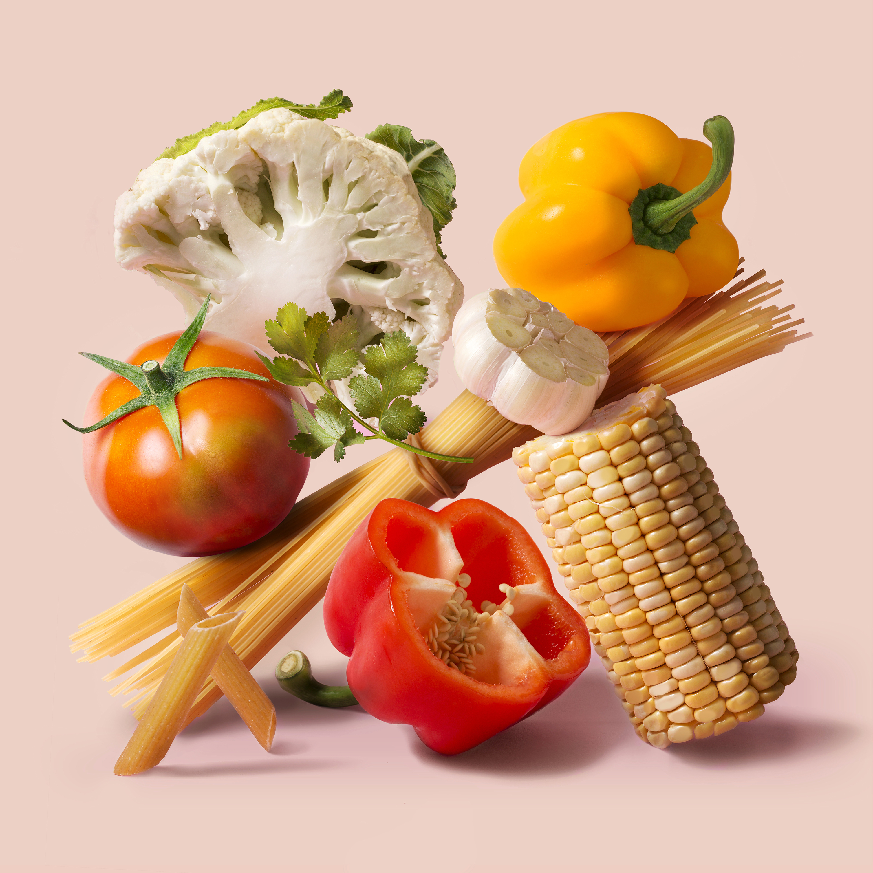
Thank you for joining the
Tu Salud Si Cuenta! movement
Introduction
Fruits and
Vegetables
Physical Activity
Portion Control
Sugar
1
2
3
4
5
Notes:
Que esperar al formar parte de TSSC mencionar estructura y duracion de los modulos
based on research - we know that if small changes are made in these areas consistently that better health will be achieved.

Slide 6
Importance Ruler
On a scale from 0-10, ¿How important is your health to you ?
0
1
2
3
4
5
6
7
8
9
10
Not at all important
Extremely important

Slide 7
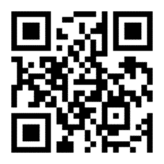
Lets Hear from a Successful Story in the Community
Spanish Video
English Video
https://fb.watch/oLb6CYIuvo/
https://vimeo.com/232875676

Slide 8
What does being healthy means to you?
Notes:
Para la mayoria de las personas, es importante estar saludable, pero pensemos individualmente nuestro significado y lo que representa la salud en nuestras vidas?
Que es para ustedes estar saludable? Cuale es el significado e interpretacion de tener salud?
Probing examples:
* Que enfermedades estan relacionadas con una falta de salud?
* Que comportamientos estan relacionados con las enfermedades?
* Como es gozar de una Buena salud para ti?
Como se logran los beneficios de una Buena salud? Y cuales son los beneficios?
For most people, it is important to be healthy, but let's think individually about our meaning and what health represents in. Instead lives.
What does being healthy mean to you? What is the meaning and interpretation of having health?
Probing examples:
What diseases are related to a lack of health?
What behaviors are related to diseases?
What is good health like for you?
How are the benefits of good health achieved?
And what are the benefits?

Slide 9
¿What prevents us or what barriers do we have for being healthy?

Slide 10
What prevents us or what barriers do you
have for being healthy?
Lack of time for cooking
Lack of time for exercising
Chronic pain
Fatigue
Lack of financial resources
Lack of support
Lack of skills/knowledge to do exercise /cooking
Culture
Portion sizes
Eating out
Lack of access
Depression/anxiety

Slide 11
What helps us deal with the challenges we face?

Slide 12
What helps us change?
Support
Benefits
Confidence
Needs
Identifying my personal reasons for wanting to change
(motivation)
Access
Another?
Reward
Consequence
Information/
knowledge
Positive
attitude
Environment
Self-efficacy
Goals
Preference
Another?

Slide 13
What motivate us to change?

Slide 14
ACTIVITY
What motivates me to be healthy?
Follow instructions
Notes:
Instrucciones de Actividad 10 minutos
Entregar a todos los participantes una esta hoja y un post it
Pedir a los participantes que anoten sus razones personales en la hoja de los circulos y anotar anonimamente la razon mas importante en un post it. Dar 5 minutos para este paso.
Pedir a los participantes que peguen el post it (sin nombre) en la hoja de flip board previamente pegada en la pared.
Promotora comparte las razones compartidas y felicita a los participantes por tener importantes razones para hacer cambios que lleven a tener una mejor salud. Dar 5 minutos para este paso.

Slide 15
Motivation is having a reason to do something. When we are motivated to
do something, we usually do it to the best of our ability.

Slide 16
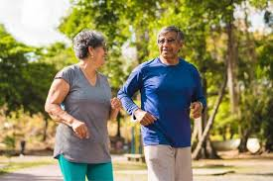
Lose weight
Grandchildren
To have better mood
Diabetes control
Children
Heart protection
Reduce stress
Energy
Inmune system
What personal reasons
do you have for
changing to
healthier
behaviors?
Notes:
Explora tus razones personales para comenzar a pensar en un cambio de habito para una vida mas saludable. Estas motivaciones son muy unicas de cada persona. Involucran sentimientos (motivaciones internas) y recompensas tangibles(motivaciones externas) que identificamos como resultado o recompenza a nuestro esfuerzo.
La o las razones deben ser claras y recordadas continuamente para que sean los motores del recorrido del cambio. El cambio es dificil pero lo hace mas facil si temenos nuetra razon de cambiar clara y constante.
Ejemplo: Mi razon para comer mas saludable es perder peso. El perder peso me hace sentir feliz y con seguridad en mi misma.
El cambio de habitos no es un camino facil, asi que la recompenza percivida tiene que valer la pena.

Slide 17
What are your goals in the program?
Identify my personal reasons for making lasting changes to improve my health
Other?
Notes:
Dejar que los participantes identifiquen una meta y dar seguimiento con
Porque los motiva esa meta?
Como piensan lograr esa meta?
Cuando lo van a lograr?
Quien te va a ayudar a lograr tu meta?
Seguir con esa misma meta para usar en la regla de confianza

Slide 18
Readiness Ruler
On a scale from 0-10, How ready are you to making a commitment (or other) to complete your participation in the program?
0
1
2
3
4
5
6
7
8
9
10
Not at all ready
Extremely ready

Slide 19
Confidence Ruler
On a scale from 0-10, How confident to do feel about making a commitment to complete your participation in the program?
0
1
2
3
4
5
6
7
8
9
10
Not at all confident
Extremely confident

Slide 20
ACTION PLAN
My GOAL is:_______________________________________________________________________________________________
Why will I do it?
How will I do it?
When will I do it?
Challenges I might face?
Ways to meet the challenges?
What benefits will I get?
Notes:
As you fill out your meal plan, think about the following:
Why you want to make healthier changes in your food patterns.
What motivates you to make changes that might not be easy but are worth doing for a better health.
Think about what barriers you may encounter and what solutions you have
Role Play an Example
Add one fruit or vegetable to every meal.
If you get fast food, ask for a salad instead of fries.
Commit to one salt-free day a week. Use herbs for flavor instead.
Keeping cut-up fruits and veggies on hand in the fridge for easy snacking.
Chose healthier takeout and fast-food options, like a grilled chicken sandwich instead of fried.

Slide 21
Handouts
Activity What motivates me to be healthy?
Action Plan
TSSC Newsletter

Slide 22
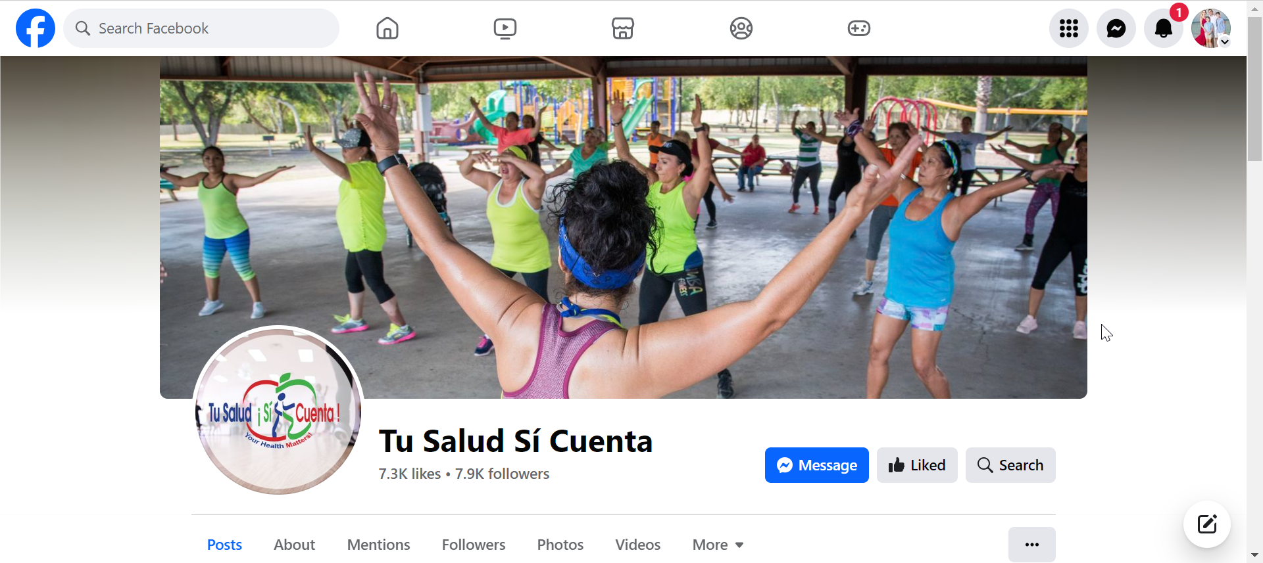
Connect with the TSSC movement!
Facebook: https://www.facebook.com/tsscRGV
Internet: http://www.tssc.info/
email: info@tssc.info

Slide 23
THANK YOU

