Slide 1
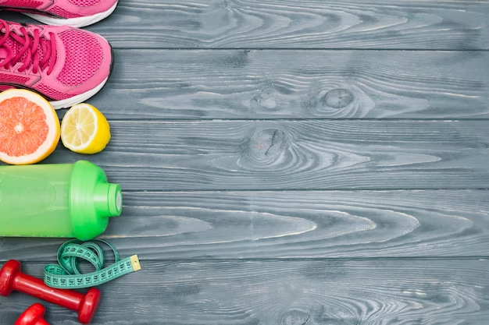
PHYSICAL ACTIVITY
A TSSC Health Coaching Module

Slide 2
Let's talk about how things have been going
since the last time we met
Notes:
PROMOTORA

Slide 3
How much time do
you spend
sitting daily?
Notes:
The first key guideline for adults is to move more and sit less.
This recommendation is based on new evidence that shows a strong positive relationship between increased sedentary behavior and increased risk of all-cause mortality, heart disease, and high blood pressure.
All physical activity, especially moderate-to-vigorous activity, can help offset these risks.
For inactive adults, replacing sedentary behavior with light-intensity physical activity is likely to produce some health benefits.
Among all adults, replacing sedentary behavior with moderate- or vigorous-intensity physical activity may produce even greater benefits.
This figure, adapted from a meta-analysis of over 1 million people by Ekelund and colleagues, demonstrates the relationship between moderate-to-vigorous physical activity and the risk of all-cause mortality.
At the greatest time spent sitting (the top), the risk of all-cause mortality begins to decrease (color becomes orange) even with small additions of moderate-to-vigorous physical activity.
At the greatest volume of moderate-to-vigorous physical activity, the risk is low even for those who sit the most (upper right corner).
At the lowest volume of moderate-to-vigorous physical activity (the left of the figure), the risk of all-cause mortality increases as time spent sitting increases.
This suggests that for inactive adults, replacing sitting time with light-intensity physical activities reduces the risk of all-cause mortality.
Although the risk of all-cause mortality is reduced as the time spent in sedentary behavior is reduced, even adults who sit the least have an elevated risk if they perform no moderate-to-vigorous physical activity (lower left corner).

Slide 4
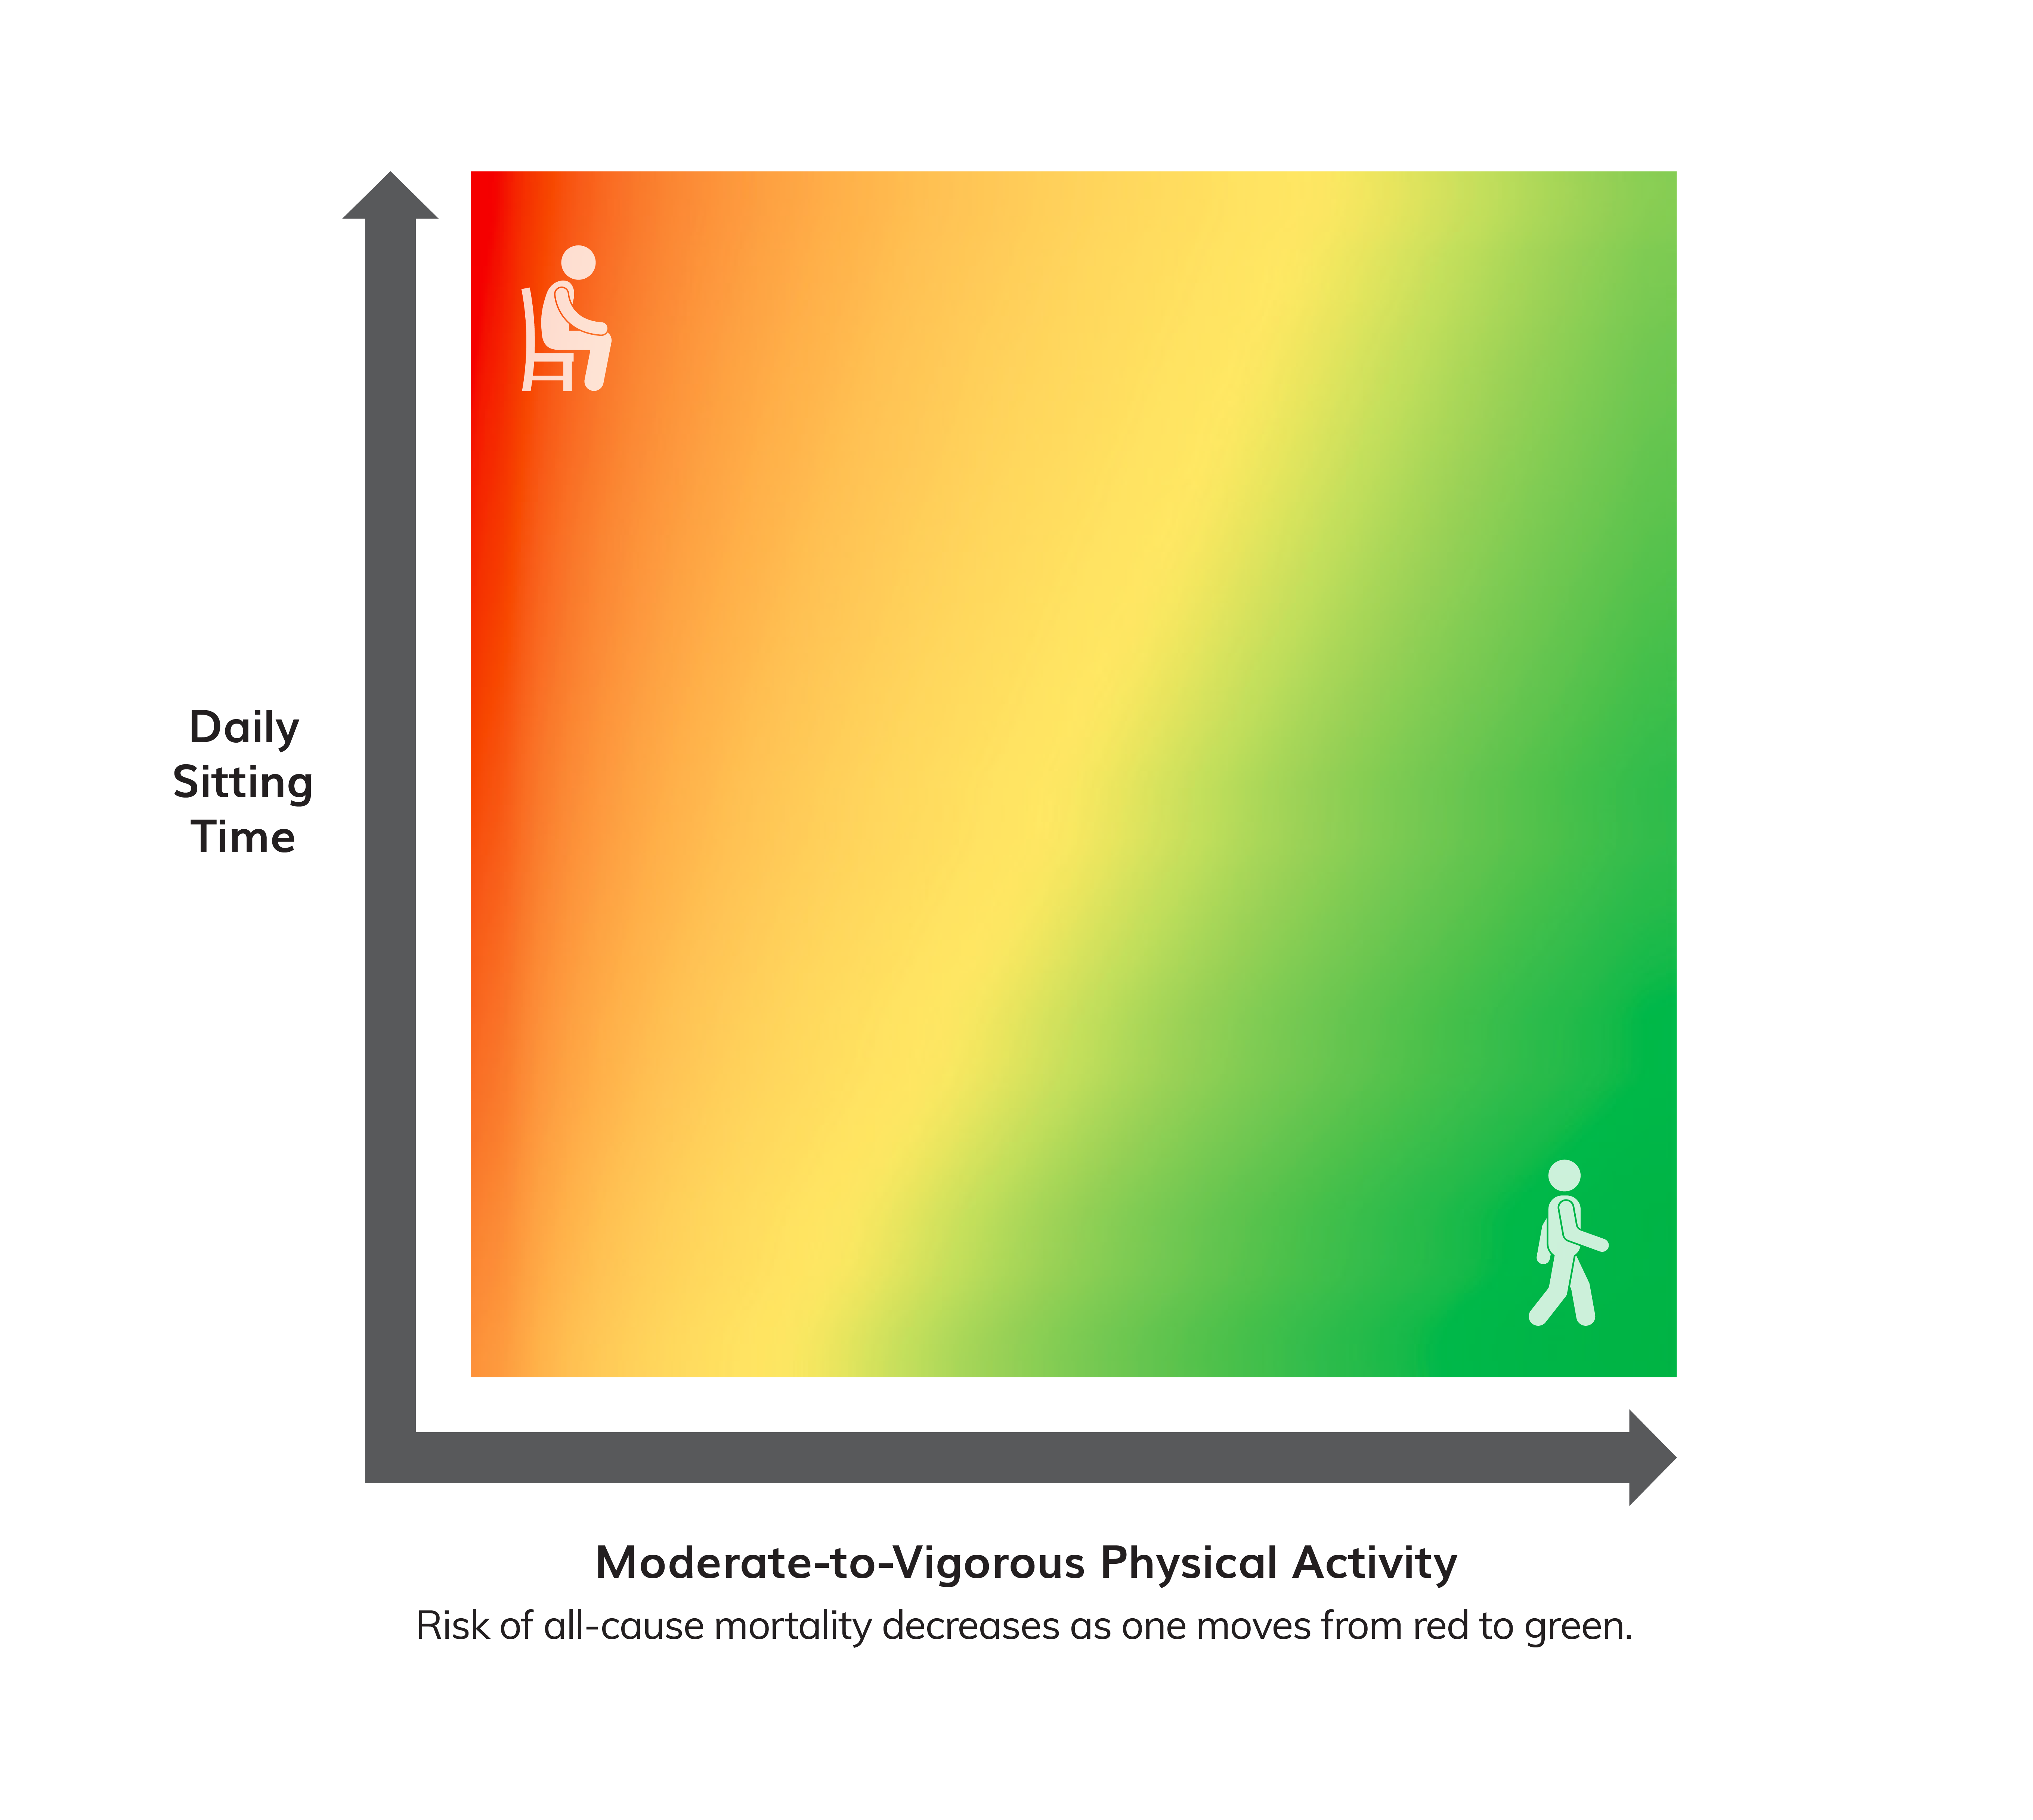
Move more and sit less!
Relationship Among Moderate-to-Vigorous Physical Activity, Sitting Time, and Risk of All-Cause Mortality in Adults
Sedentary behavior increases
risk of:
All-cause mortality
Cardiovascular disease mortality
Cardiovascular disease
Type 2 diabetes
Colon, endometrial, and lung cancers
Notes:
The first key guideline for adults is to move more and sit less.
This recommendation is based on new evidence that shows a strong positive relationship between increased sedentary behavior and increased risk of all-cause mortality, heart disease, and high blood pressure.
All physical activity, especially moderate-to-vigorous activity, can help offset these risks.
For inactive adults, replacing sedentary behavior with light-intensity physical activity is likely to produce some health benefits.
Among all adults, replacing sedentary behavior with moderate- or vigorous-intensity physical activity may produce even greater benefits.
This figure, adapted from a meta-analysis of over 1 million people by Ekelund and colleagues, demonstrates the relationship between moderate-to-vigorous physical activity and the risk of all-cause mortality.
At the greatest time spent sitting (the top), the risk of all-cause mortality begins to decrease (color becomes orange) even with small additions of moderate-to-vigorous physical activity.
At the greatest volume of moderate-to-vigorous physical activity, the risk is low even for those who sit the most (upper right corner).
At the lowest volume of moderate-to-vigorous physical activity (the left of the figure), the risk of all-cause mortality increases as time spent sitting increases.
This suggests that for inactive adults, replacing sitting time with light-intensity physical activities reduces the risk of all-cause mortality.
Although the risk of all-cause mortality is reduced as the time spent in sedentary behavior is reduced, even adults who sit the least have an elevated risk if they perform no moderate-to-vigorous physical activity (lower left corner).

Slide 5
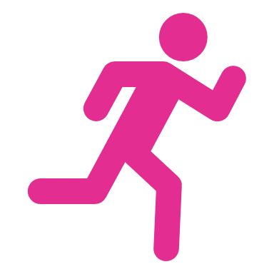
DID YOU KNOW?
Adults aged 18 and over who met the Physical Activity Guidelines for aerobic physical activity: 46.9%
Percent of adults aged 18 and over who met the Physical Activity Guidelines for both aerobic and muscle-strengthening activity: 24.2%
Notes:
Depending on their age and sex federal guidelines recommend that adults eat at least 1½ to 2 cups per day of fruitexternal icon and 2 to 3 cups per day of vegetablesexternal icon as part of a healthy eating pattern.
“This report highlights that very few Americans eat the recommended amount of fruits and vegetables every day, putting them at risk for chronic diseases like diabetes and heart disease,”

Slide 6
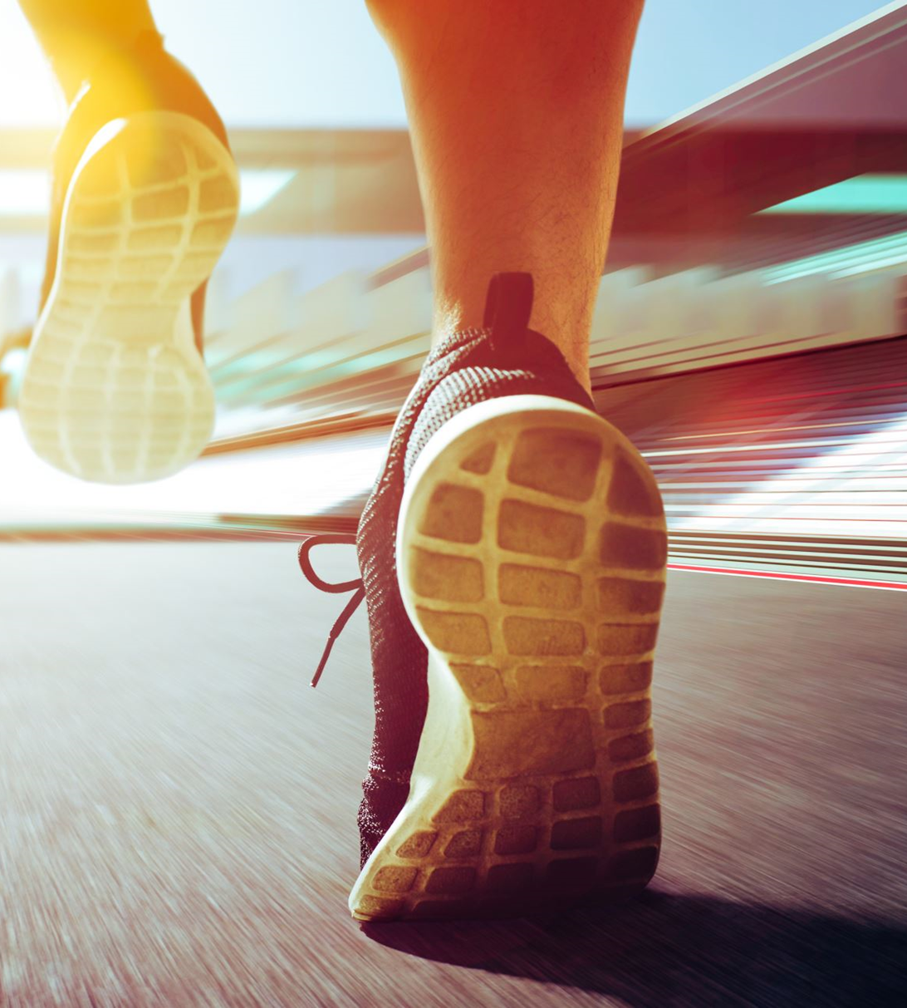
Understanding the Key Guidelines for Adults:
2 Types of Activity:
TYPE | EXAMPLES | BENEFIT
1. Aerobic (also called “your endurance”, “cardio activities”) | Running, brisk walking, bicycling, playing basketball, dancing, swimming. | makes a person’s heartbeat more rapidly and the breathing rate increases to meet the demands of the body’s movement.
2. Muscle strengthening | Lifting weights, working with resistance bands, push ups, pull ups, and planks, carrying heavy loads, and heavy gardening. | Help maintain muscle mass during weight loss
Notes:
The key guidelines for adults focus on two types of activity— aerobic and muscle strengthening. Each provides important health benefts.
When adults do the equivalent of at least 150 minutes of moderate-intensity aerobic activity each week, the benefts are substantial. These benefts include lower risk of all-cause mortality, coronary heart disease, stroke, hypertension, type 2 diabetes, some cancers, anxiety, depression, and Alzheimer’s disease and other dementias. Physically active adults also sleep better, have improved cognition, and have better quality of life. As a person moves from 150 minutes a week toward 300 minutes a week, the health benefts become more extensive. For example, a person who does 300 minutes a week has an even lower risk of heart disease or type 2 diabetes than a person who does 150 minutes a week. Furthermore, adults who are regularly active at or near the higher end of the key guideline range—300 minutes a week—gain additional health benefts. These additional benefts include further risk reduction for several cancers and prevention of unhealthy weight gain (by physical activity alone). The benefts continue to increase when a person does more than the equivalent of 300 minutes a week of moderate-intensity aerobic activity. Research has not identifed an upper limit of total activity, above which additional health benefts cease to occur

Slide 7
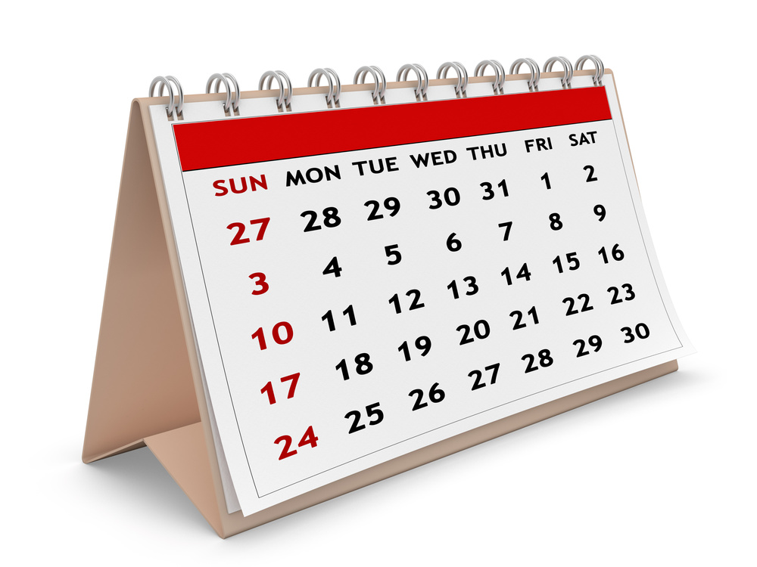
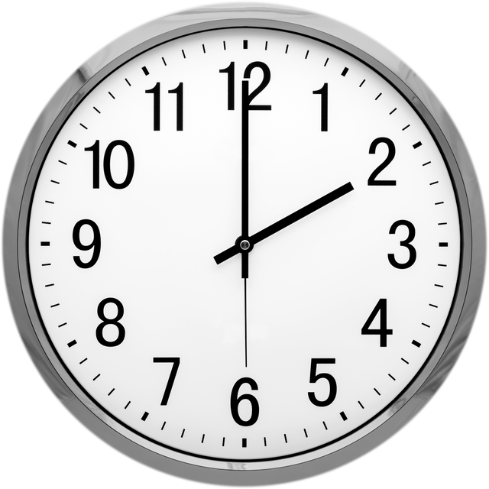
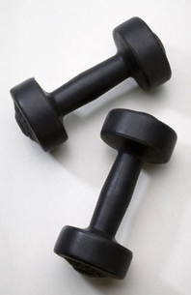
FREQUENCY - HOW OFTEN ARE YOU PHYSICALLY ACTIVE?
Intensity - Your level of physically activity
STAY HEALTHY BY STAYING "FITT"
Time - How long are you physically active?
Type - Aerobic or strength
Notes:
Use the FITT model to get your regular physical activity.
• Frequency
• Intensity
• Time
• Type
Let’s discuss each briefly…
Frequency – how often you are physically active
Intensity – your level of exertion during physical activity – how hard you push yourself
Time – amount of time you spend being active.
The CDC recommendation is for at least 30 minutes most days for adults.
Type – the kind of activity you are doing
Aerobic activity
• For substantial health benefits, adults should do at least 150 minutes (2 hours and 30 minutes) to 300 minutes (5 hours) a week of moderate-intensity, or 75 minutes (1 hour and 15 minutes) to 150 minutes (2 hours and 30 minutes) a week of vigorous-intensity aerobic physical activity, or an equivalent combination of moderate- and vigorous-intensity aerobic activity.
• Preferably, aerobic
activity should be spread throughout the week.
• You should also do muscle-strengthening activities of moderate or greater intensity and that involve all major muscle groups on 2 or more days a week.
If that’s more than you can do right now, do what you can. Even 5 minutes of physical activity has real health benefits.
Citation:
2018 Physical Activity Guidelines Advisory Committee. Physical Activity Guidelines for Americans, 2nd. Updated [2018]. Accessed July 6, 2022. https://health.gov/sites/default/files/2019-09/Physical_Activity_Guidelines_2nd_edition.pdf

Slide 8
PHYSICAL ACTIVITY
BODY MOVEMENT THAT USES ENERGY
Light Intensity
Vigorous Intensity
MODERATE INTENSITY
Exercise is a subcategory of physical activity.
Notes:
Physical activity refers to any bodily movement produced by the contraction of skeletal muscle that increases energy expenditure above a
basal level.
Housework and tending to a garden and other activities of this level with slower movements, pauses, or not lasting at least 10 minutes do not provide the same benefits to your health as moderate or vigorous activity.
These physical activities are done more slowly, which are considered to be a light exercise and do not burn sufficient energy.
Moderate physical activity can condition your heart and lungs and reduce the risk of cardiac illnesses.
Examples of moderate intensity exercises are:
• Water aerobics
• Ballroom or line dancing
• Walking briskly (2.5 miles per hour or faster)
Vigorous activities better condition your heart and lungs and tend to burn more calories.
Vigorous intensity exercises are:
• Jogging or running
• Jumping rope
• High-intensity interval training (HIIT)
The talk test is a simple way to measure relative intensity. In general, if you’re doing moderate-intensity activity, you can talk but not sing during the activity.
Although, moderate levels of activity can also be excellent options of exercise. It will be difficult to carry on a conversation.
• Exercise is a form of physical
activity that is planned, structured, repetitive, and performed with the goal of improving health or fitness.
Get moving! You can burn more calories through physical activity. The great thing about adding activity to the equation is all the additional health benefits.
Citations:
2018 Physical Activity Guidelines Advisory Committee. Physical Activity Guidelines for Americans, 2nd. Updated [2018]. Accessed July 6, 2022. https://health.gov/sites/default/files/2019-09/Physical_Activity_Guidel
Centers for Disease and Prevention. (XXX). Measuring physical activity intensity. https://www.cdc.gov/physicalactivity/basics/measuring/index.html

Slide 9
Light-intensity exercise
Your heart beats at a normal rate.
Examples:
Slow walk
Gardening
House cleaning
Childcare
Notes:
Niveles de intensidad-Generalmente, cuanto más energía se involucra en una actividad, y cuanto más tiempo pasa haciéndola, serán mas los beneficios, que usted recibirá

Slide 10
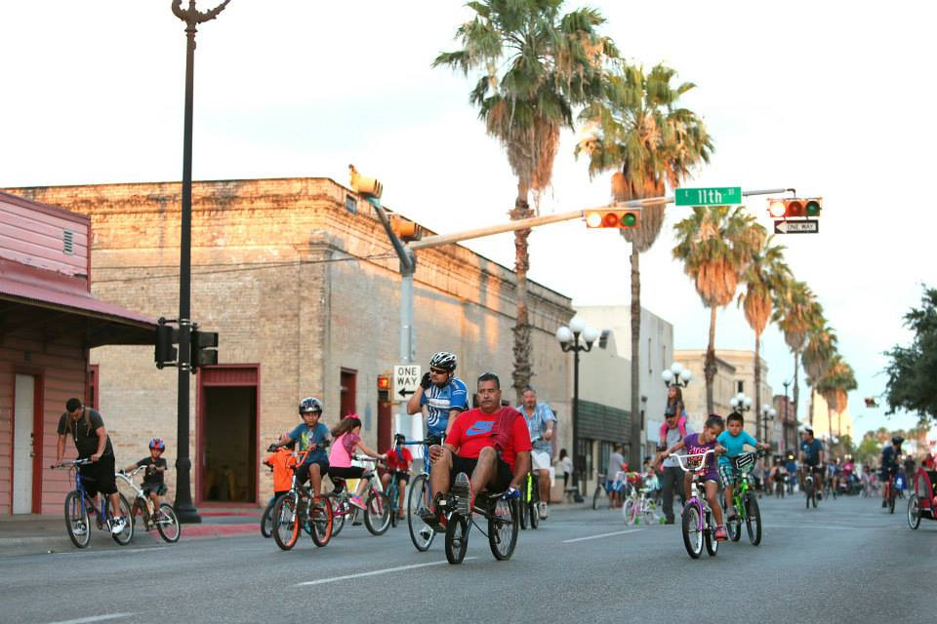
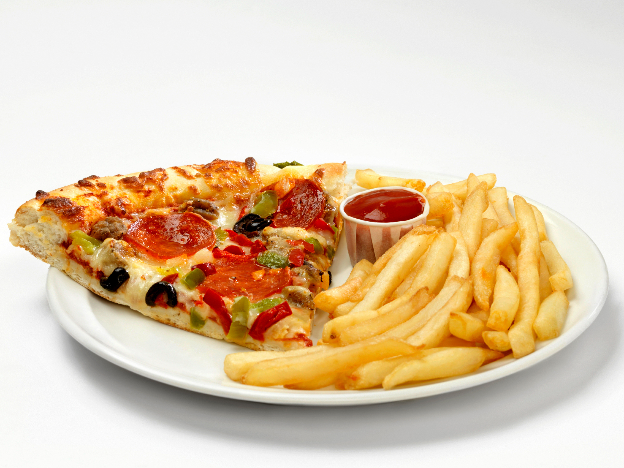
Moderate-intensity exercise
Your heart beats at a faster rate than normal, yet you are able to have a conversation while doing the exercise.
Examples:
Brisk walking
Riding a bike
Dancing
Notes:
Las actividades de intensidad moderada también pueden ser excelentes opciones de ejercicio. Cuando se hace con energía durante 30 minutos o la mayoría de los días de la semana, las actividades de intensidad moderada pueden ayudar a la condición de su corazón y los pulmones y reducir el riesgo de enfermedades cardiacas.

Slide 11
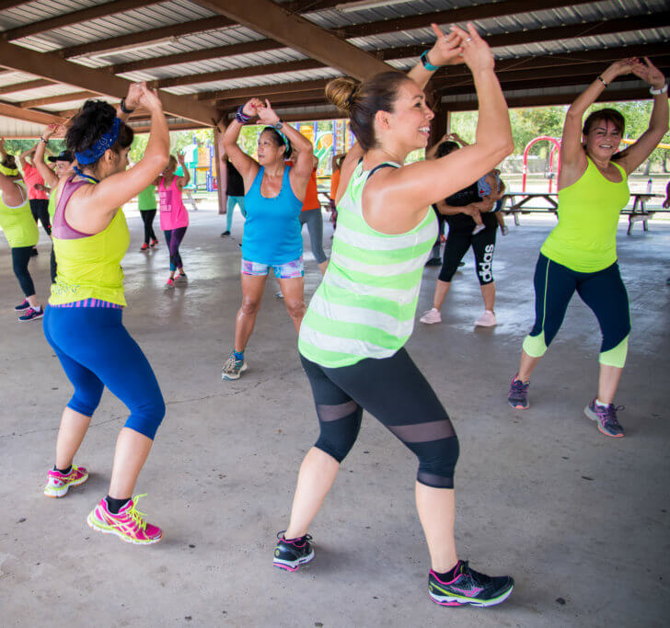
Vigorous-intensity exercise
Your heart typically beats faster than normal and makes it difficult to talk.
Examples:
Jogging or running
Aerobics, Zumba
Playing basketball
Notes:
Las actividades vigorosas resultan especialmente útiles para el acondicionamiento de su corazón y pulmones, y también se queman más calorías.

Slide 12
Physical activity diary to keep track of our daily progress
How much are you moving daily?
Day of the Week | Type of activity | Intensity | Location | Time
Sunday
Monday
Tuesday
Wednesday
Thursday
Friday
Saturday

Slide 13
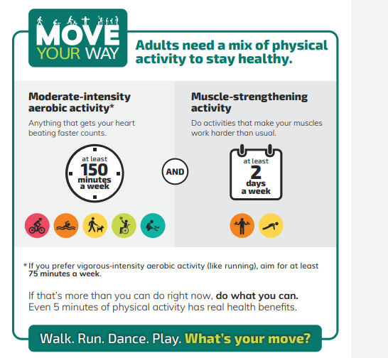
What are the guidelines for physical activity for adults?

Slide 14
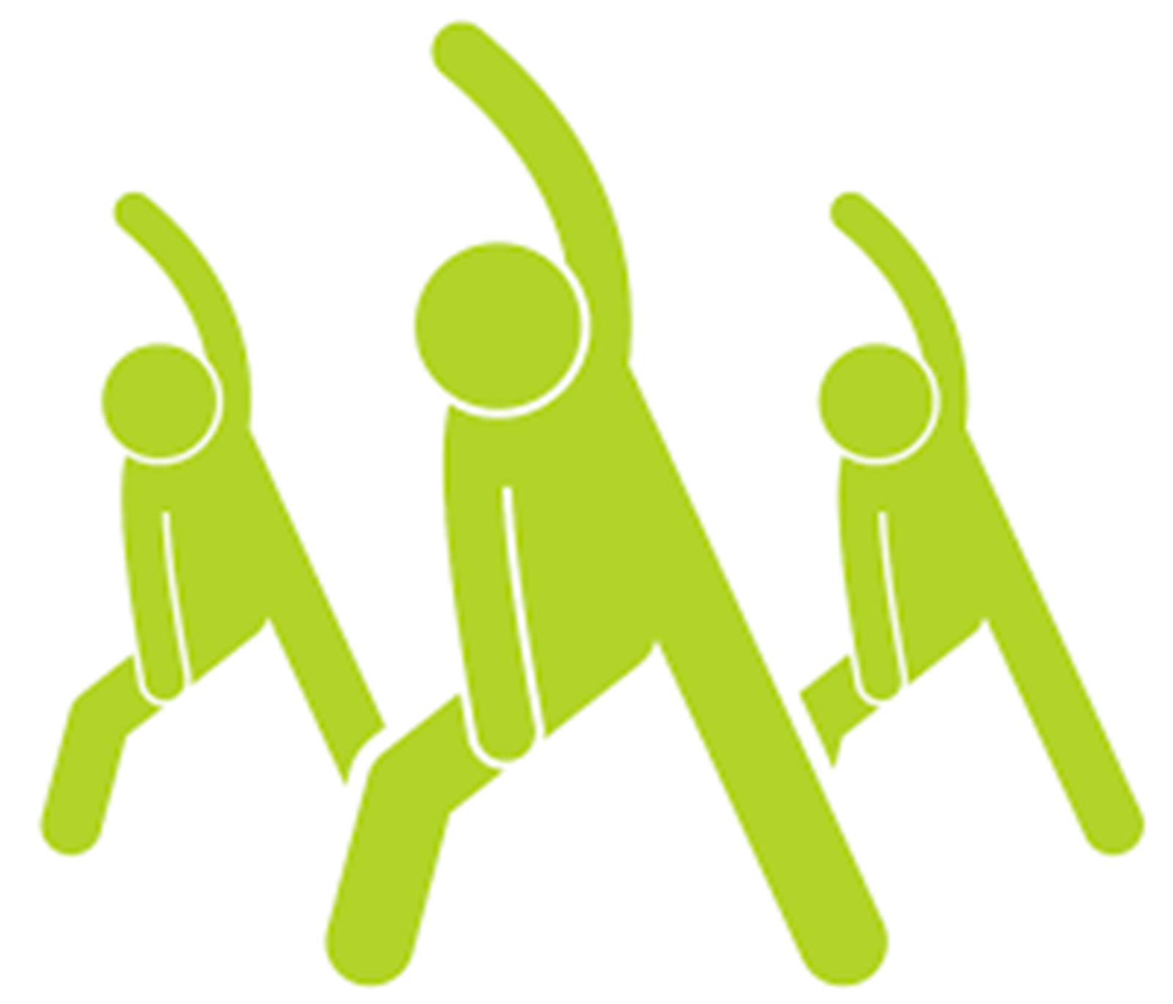
Activity Demonstration "A Moverse" ejercicio en silla.mp4

Slide 15
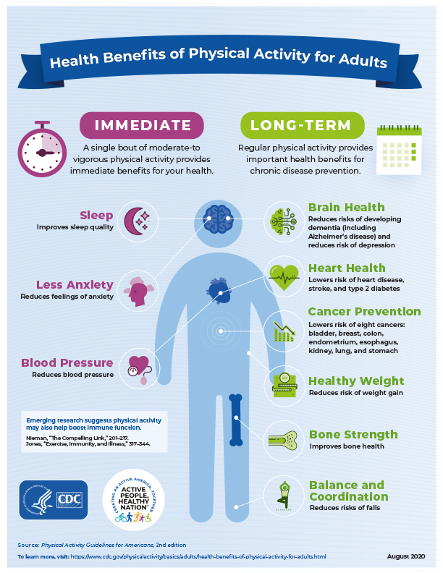
BENEFITS OF PHYSICAL ACTIVITY AND ITS RELATIONSHIP TO DISEASE CONTROL
Notes:
Source:
https://www.cdc.gov/chronicdisease/resources/publications/factsheets/nutrition.htm
Overweight and Obesity
Eating a healthy diet, along with getting enough physical activity and sleep, can help children grow up healthy and prevent overweight and obesity. In the United States, 20% of young people aged 2 to 19 years and 42% of adults have obesity, which can put them at risk of heart disease, type 2 diabetes, and some cancers.
Heart Disease and Stroke
Two of the leading causes of heart disease and stroke are high blood pressure and high blood cholesterol. Consuming too much sodium can increase blood pressure and the risk for heart disease and stroke. Current guidelines recommend getting less than 2,300 mg a day, but Americans consume more than 3,400 mg a day on average.
Over 70% of the sodium that Americans eat comes from packaged, processed, store-bought, and restaurant foods. Eating foods low in saturated fats and high in fiber and increasing access to low-sodium foods, along with regular physical activity, can help prevent high blood cholesterol and high blood pressure.
Type 2 Diabetes
People who are overweight or have obesity are at increased risk of type 2 diabetes compared to those at a healthybecause, over time, their bodies become less able to use the insulin they make. Of US adults, 96 million—more than 1 in 3—have prediabetes, and more than 8 in 10 of them don’t know they have it. Although the rate of new cases has decreased in recent years, the number of adults with diagnosed diabetes has nearly doubled in the last 2 decades as the US population has increased, aged, and become more overweight.
Cancer
An unhealthy diet can increase the risk of some cancers. Consuming unhealthy food and beverages, such as sugar-sweetened beverages and highly processed food, can lead to weight gain, obesity and other chronic conditions that put people at higher risk of at least 13 types of cancer, including endometrial (uterine) cancer, breast cancer in postmenopausal women, and colorectal cancer. The risk of colorectal cancer is also associated with eating red and processed meat.
Menor riesgo de:
Muerte prematura
Diabetes tipo 2
Cancer de colon
Cancer de mama
Obesidad o sobrepeso
Hipertension arterial
Enfermedad coronaria
Accidente cerebro-vascular
Mejora:
Condicion cardio respiratoria
Capacidad muscular
Función cognitiva (para adultos mayores)
Perdida de peso
combinado con un mantenimiento o reducción de la ingesta calórica
Prevencion de caidas
Reduccion de estres
Reduccion de depresion

Slide 16
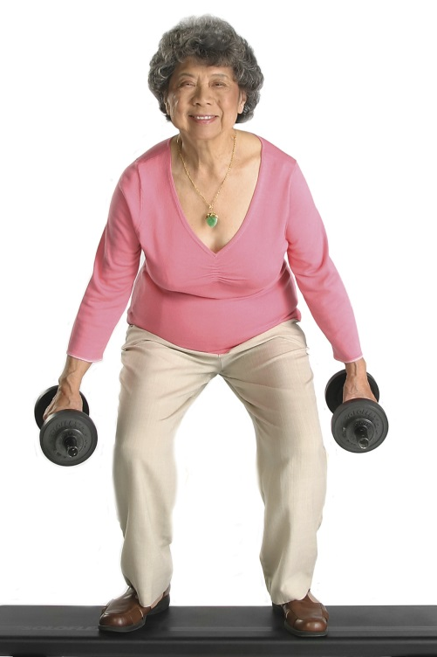
“As you get older you need less physical ACTIVITY"
Notes:
Regular physical activity increases the abilities of older adults to remain doing their daily routines and be independent for a longer period of time. Even when we know that physical activity is good for us, it is easy to keep on being sedentary. We all have reasons to remain inactive, but at times this reasons can be based more on myths than reality. These are some of the most common myths associated with physical activity and some ways of replacing it with a more realistic one, it is possible to do it with a positive attitude of “yes I can.” Ask the person if they have ever felt this way. Ask how they will apply these concepts.

Slide 17
FALSE
Being physically active is important throughout life.
Find a physical activity program that adapts to your individual fitness level and needs.
Notes:
Regular physical activity increases the abilities of older adults to remain doing their daily routines and be independent for a longer period of time. Even when we know that physical activity is good for us, it is easy to keep on being sedentary. We all have reasons to remain inactive, but at times this reasons can be based more on myths than reality. These are some of the most common myths associated with physical activity and some ways of replacing it with a more realistic one, it is possible to do it with a positive attitude of “yes I can.” Ask the person if they have ever felt this way. Ask how they will apply these concepts.

Slide 18
“You need to be athletic to do exercise.”
Notes:
De hecho, muchas personas que tenían malos recuerdos de los deportes escolares difíciles han descubierto todo un mundo de actividades agradables y saludables que no presentan ningún talento especial o entrenamiento en especial. Un ejemplo perfecto es caminar a paso acelerado-una actividad excelente para mantener el corazón saludable. Otros incluyen el ciclismo, trabajo en el jardín (cavar posos o limpiar mas no con solo regar), siempre y cuando haya se hagan a un ritmo acelerado. Solo haga más de las actividades que ya le gustan y ya sabe cómo hacer. Es así de simple.

Slide 19
FALSE
Most physical activities do not require any special athletic skills.
Brisk walking
Riding a bike
Dancing, Zumba, Aerobics
Notes:
De hecho, muchas personas que tenían malos recuerdos de los deportes escolares difíciles han descubierto todo un mundo de actividades agradables y saludables que no presentan ningún talento especial o entrenamiento en especial. Un ejemplo perfecto es caminar a paso acelerado-una actividad excelente para mantener el corazón saludable. Otros incluyen el ciclismo, trabajo en el jardín (cavar posos o limpiar mas no con solo regar), siempre y cuando haya se hagan a un ritmo acelerado. Solo haga más de las actividades que ya le gustan y ya sabe cómo hacer. Es así de simple.

Slide 20
What are some barriers and challenges you have that stop you from doing physical activity?
Notes:
Incluso cuando se sabe que la actividad física es buena para uno, es fácil seguir siendo sedentarios. Todos tenemos razones para permanecer inactivos, pero a veces esas razones se basan más en mitos que la realidad. Éstos son algunos de los mitos más comunes acerca de la actividad física y la forma de reemplazarlo con uno más realista, es posible hacerlo con un animo positivo de “si se puede”.
Superar la barrera del no tengo tiempo: dar el ejemplo de un estudio que se hizo en donde se hizo encuentas a gente activa y sedentaria y los dos grupos de personas dieron las mismas barreras para no hacer ejercicio siendo una de ellas el no tener tiempo. Pero aqui se demuestra que todo mundo tenemos la barrera de no tener tiempo pero tambien todo mundo se puede dar el tiempo en su dia para hacer ejercicio.
Preguntar a la persona si alguna vez se han sentido así. Preguntar cómo se podrían aplicar estos consejos
Dar un ejemplo de su propia experiencia. ---
Preguntar: ¿Alguna vez se ha sentido así?
Dar el ejemplo de como un carro si no se usa se descompone (se le muere la bateria y se puede hasta pegar el motor) hay que usar nuestro cuerpo moviendonos porque vamos a sentirnos mas cansados cuando no lo usamos.

Slide 21
BARRIERS AND SOLUTIONS
“Exercising takes a long time”. | Physical activity does take time, but there are different ways to make it more manageable: Start with 10-minute periods of PA throughout each day. Set a time for physical activity early in the morning, before the rest of your daily activities Combine your physical activity with something that is already part of your daily routine.
“Exercise makes you tired.” | Once you start out a physical activity routine, it can help you feel energized. Moderate-to-vigorous physical activity can help you to reduce tireness and manage stress.
“I don’t like to exercise” | Try different strategies before giving up! Different schedule Invite a friend Different type of activity
Notes:
Incluso cuando se sabe que la actividad física es buena para uno, es fácil seguir siendo sedentarios. Todos tenemos razones para permanecer inactivos, pero a veces esas razones se basan más en mitos que la realidad. Éstos son algunos de los mitos más comunes acerca de la actividad física y la forma de reemplazarlo con uno más realista, es posible hacerlo con un animo positivo de “si se puede”.
Superar la barrera del no tengo tiempo: dar el ejemplo de un estudio que se hizo en donde se hizo encuentas a gente activa y sedentaria y los dos grupos de personas dieron las mismas barreras para no hacer ejercicio siendo una de ellas el no tener tiempo. Pero aqui se demuestra que todo mundo tenemos la barrera de no tener tiempo pero tambien todo mundo se puede dar el tiempo en su dia para hacer ejercicio.
Preguntar a la persona si alguna vez se han sentido así. Preguntar cómo se podrían aplicar estos consejos
Dar un ejemplo de su propia experiencia. ---
Preguntar: ¿Alguna vez se ha sentido así?
Dar el ejemplo de como un carro si no se usa se descompone (se le muere la bateria y se puede hasta pegar el motor) hay que usar nuestro cuerpo moviendonos porque vamos a sentirnos mas cansados cuando no lo usamos.

Slide 22
REMEMBER…
Tips for cardiovascular exercise:
Warm up before you start your workout.
Stay hydrated before, during and after exercise.
Stretch your body to avoid injuries.
Use comfortable cloths and suitable shoes.
Notes:
Burn 755 calories in 5 days to feel super agile and light.

Slide 23
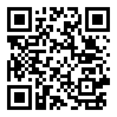
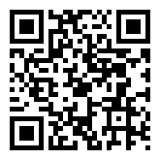
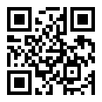
Role Model Stories
ROLE MODEL VIDEOS
Notes:
https://vimeo.com/240038358
¿Qué opinas del cambio que logró?
¿Cómo te identificas con esta historia?
¿Qué motivaciones consideras que tienes tú para lograr hacer un cambio como el de esta historia?
¿De qué manera crees que esta historia puede inspirarte?

Slide 24
IMPORTANCE RULER
0
1
2
3
4
5
6
7
8
9
10
Not important at all
Somehow important
Very important
IMPORTANCE RULER
How important is it for you to exercise?

Slide 25
TAKE CONTROL
By focusing on your actions
GOAL
Between now and my next appointment, my goal is to:
ACTION PLAN
✓ What you will do
✓ Why
✓ Where you will do it
✓ When you will do it
✓ How long you will do it
What challenges might you face?
How would you overcome them?
Notes:
When creating your action plan, it is important to know the following:
✓ What you will do
✓ Where you will do it
✓ When you will do it
✓ How long you will do it
Setting goals can be the first step in creating your action plan to engaging in physical activity.
A possible goal might be to engage in 30 minutes of exercise a day between now and the next appointment with your healthcare provider. To achieve that goal, you could take a walk in a park in the before or after work.
When creating your goals, be mindful of what challenges might you face and how would you overcome them.
What could be your own personal goal for engaging in physical activity?

Slide 26
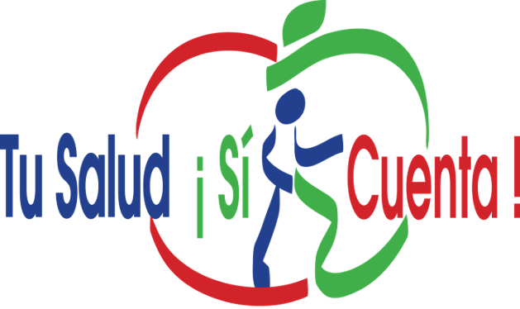
ACTION PLAN
My GOAL is:_______________________________________________________________________________________________
Why will I do it?
How will I do it?
When will I do it?
Challenges I might face?
Ways to meet the challenges?
What benefits will I get?
Notes:
As you fill out your meal plan, think about the following:
Why you want to make healthier changes in your food patterns.
What motivates you to make changes that might not be easy but are worth doing for a better health.
Think about what barriers you may encounter and what solutions you have
Role Play an Example
Add one fruit or vegetable to every meal.
If you get fast food, ask for a salad instead of fries.
Commit to one salt-free day a week. Use herbs for flavor instead.
Keeping cut-up fruits and veggies on hand in the fridge for easy snacking.
Chose healthier takeout and fast-food options, like a grilled chicken sandwich instead of fried.

Slide 27
READINESS RULER
0
1
2
3
4
5
6
7
8
9
10
Not ready at all
Somewhat ready
Ready
Readiness Ruler
On a scale of 0-10, how ready are you to start being physically active?

Slide 28
CONFIDENCE RULER
0
1
2
3
4
5
6
7
8
9
10
Not confident
Somewhat confident
Very confident
CONFIDENCE SCALE
On a scale of 0-10, how ready are you to start being physically active?

Slide 29
HANDOUTS
Current physical activity tracking sheet Action Plan

Slide 30
REFERENCES

