Slide 1
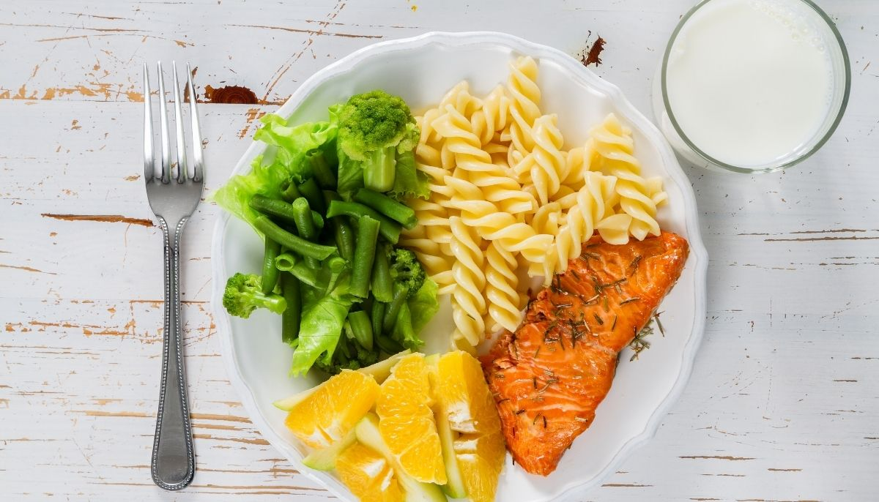
PORTION CONTROL
A TSSC Health Coaching Module
Notes:
We are at half way from concluding the TSSC modules.
We started with the introduction module that included thinking about our own reasons for wanting to live a healthier life.
Second module, fruits and vegetables
Physical activity
And today portion control

Slide 2
Let's talk about how your action plan has been going
since the last time we met
Notes:
Lets start with talking about successful successful stories about changes that have started on the previous topic

Slide 3
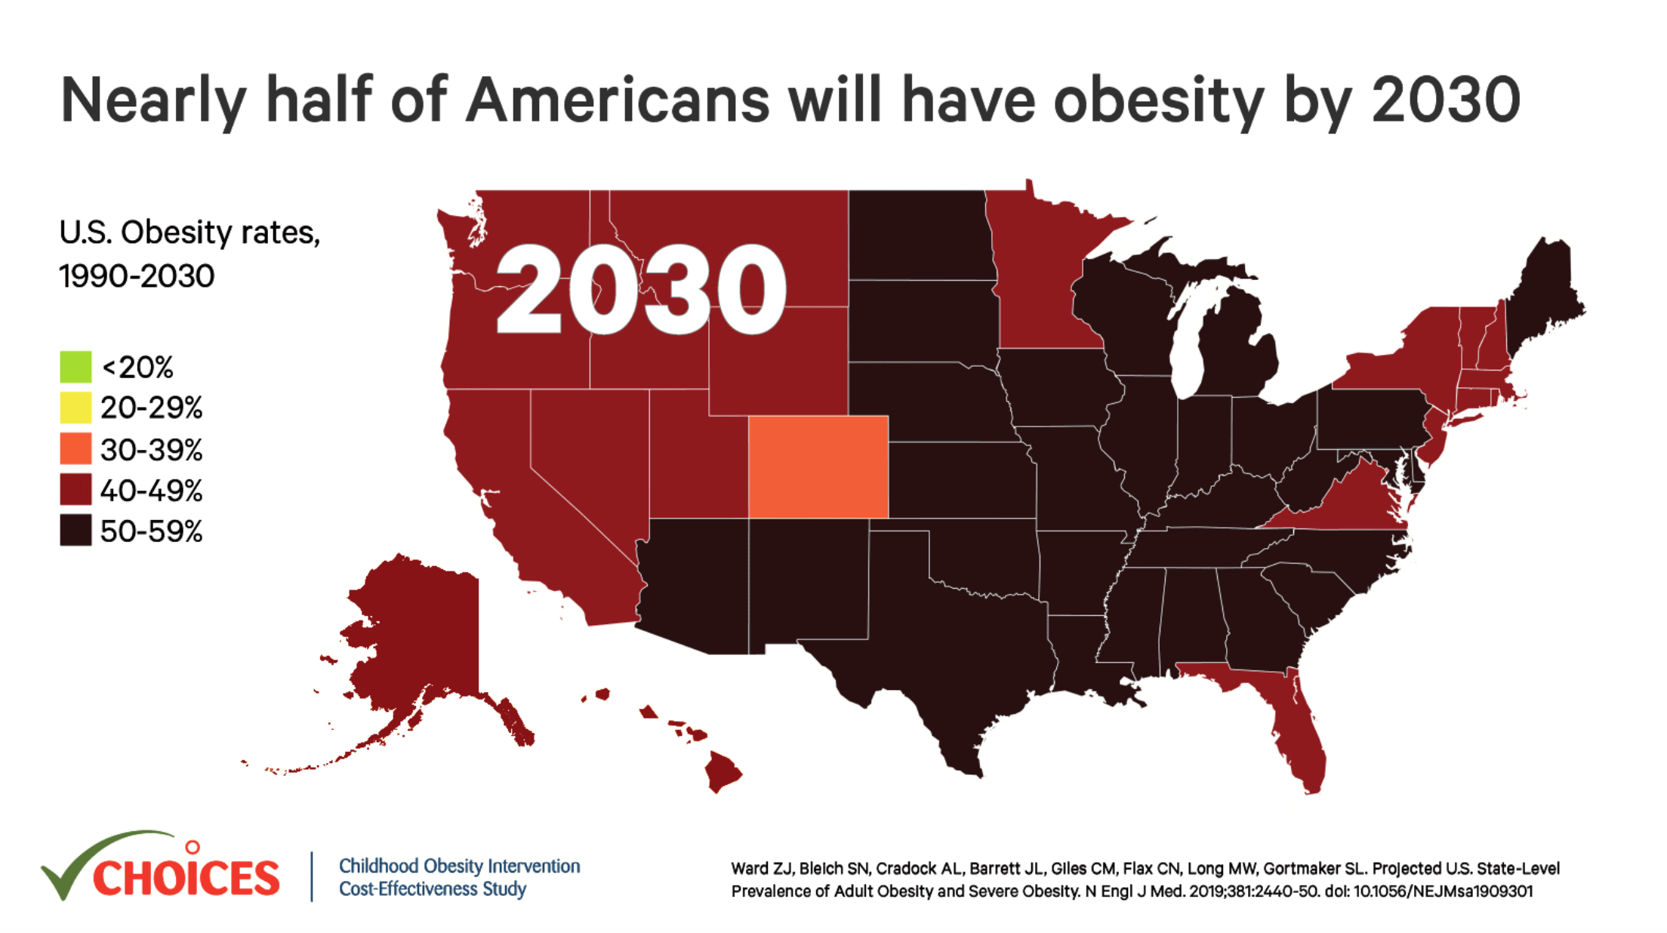
Did you know?
Notes:
Lets review the alarming fact so we can become aware of the importance of this topic.
What can we see in here:
The projection shows we are 6 years from having a population with obesity
RGV more than 50%
Treating obesity includes making changes to diet and incorporating regular exercise into ones daily routine. By making these changes, you reduce the risk of developing serious health conditions, such as high blood pressure, high cholesterol, diabetes, heart disease, stroke and cancer.

Slide 4
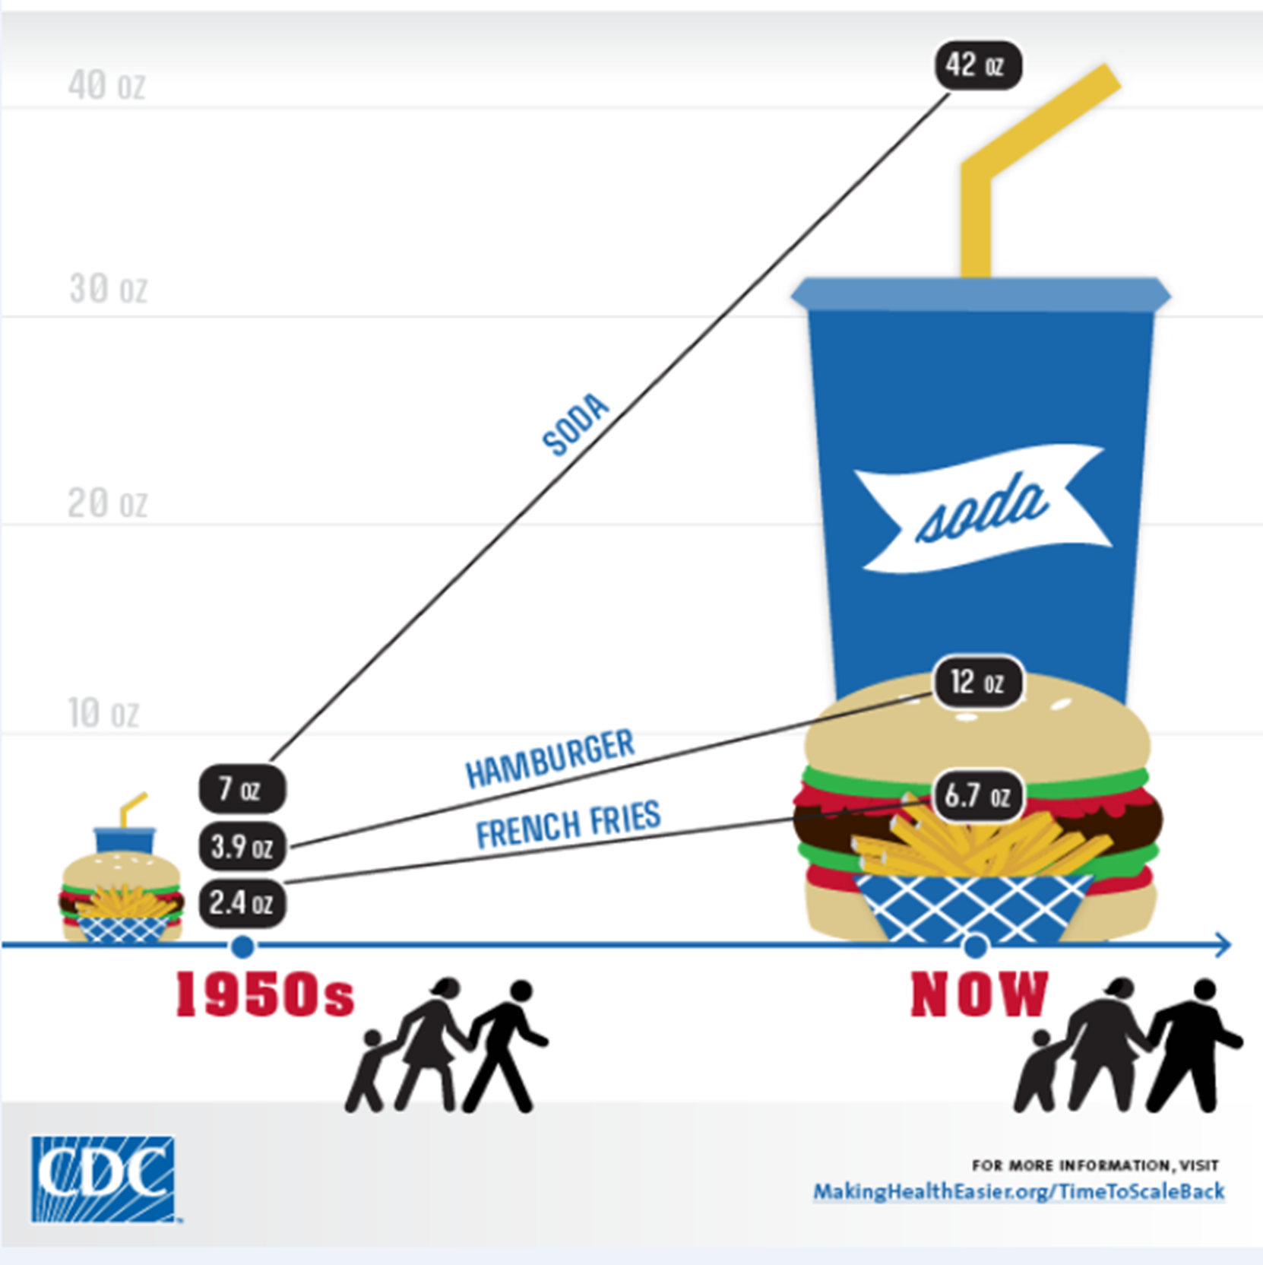
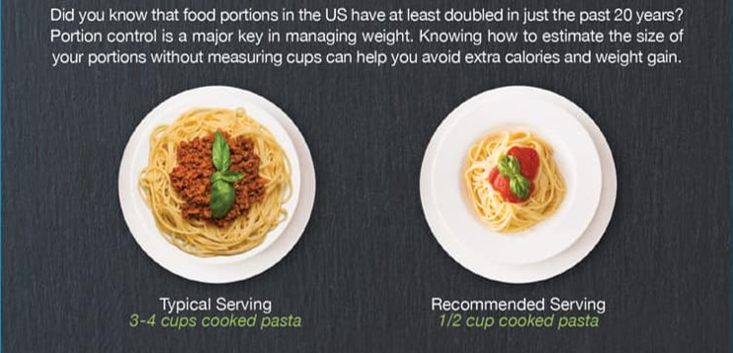
Portion Distortion
Notes:
Increased portions is the main factor

Slide 5
ACTIVITY
What does your plate look like?
Think about your heaviest meal you had yesterday
Notes:
To get started, we are going to talk about a basic framework, or guidance for eating. By show of hands, who recognizes this image? This is the USDA’s food guidance system for the country and can be used to guide your food choices. The plate represents each of the five food groups which are fruits, vegetables, protein, grains and dairy. The plate shows how each of the five food groups fits into a healthy meal. The concepts represented in this plate are:
1) Proportion: What do you notice about how each food group is represented on the plate? Wait five seconds for responses. The five food 3 groups are represented in different proportions that can be used to guide how you plan what types of foods are in your meals. The recommendation is to make half your plate fruits and vegetables; a little more than a quarter of your plate grains, choosing whole grains at least 50 percent of the time, and less than a quarter of your plate lean protein foods. Dairy foods are a good accompaniment to meals, and low-fat plain dairy foods are recommended for anyone over two years of age.
2) Variety: The meal represented on the plate contains all five food groups. While it may be difficult to eat food from all five groups at each meal, it’s important to include foods from each food group in the meals and snacks you eat throughout the day. Eating a variety of foods every day allows you to get all the nutrients your body needs.
Purpose of Food Groups As nutrition science has progressed over time, scientists have discovered vitamins, minerals, and other components that make up our foods, and surely, there are more yet to be discovered. Food groups simplify dietary recommendations by focusing on foods instead of nutrients. For example, it’s much easier to try to eat two cups of fruit a day than 75 milligrams of vitamin C and 25 grams of fiber. The USDA Food Patterns provide the recommended amounts of each food group and subgroup at 12 different calorie levels, ranging from 1,000 to 3,200. These patterns are developed using food pattern modeling. By eating recommended amounts, individuals can meet their nutritional needs without having to track dozens of individual nutrients.
Food Group Amounts The USDA Food Patterns specify targets for each food group in cup equivalents (for Fruits, Vegetables, and Dairy) and ounce equivalents (for Grains and Protein Foods). Each pattern also includes a limited number of calories (8-19%) that can be used in other ways, such as small amounts of added sugars and saturated fats. Americans are encouraged to choose foods in their most nutrient dense forms as often as possible, to keep added sugars and saturated fat intakes each below 10 percent of total calorie intake.

Slide 6
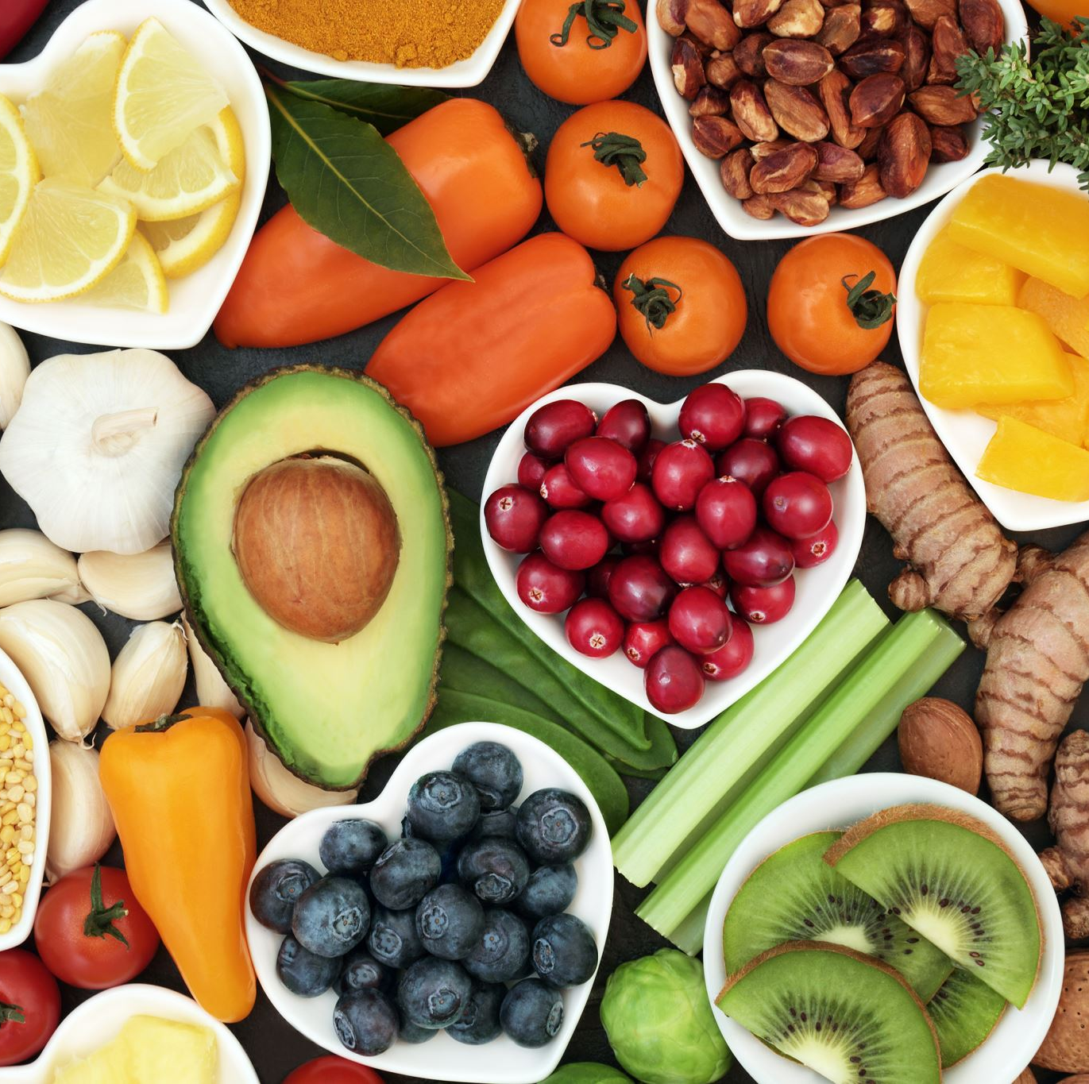
What does it mean to eat in portions?
Portion control means choosing a healthy amount of a certain food.
Portion control helps you get the benefits of nutrients in food without overeating
Notes:
One main updated messages the new dietary guidelines are focusing are the
importance of nutrients into our diets VARIETY is key
and the right portions (ni mucho ni poco)

Slide 7
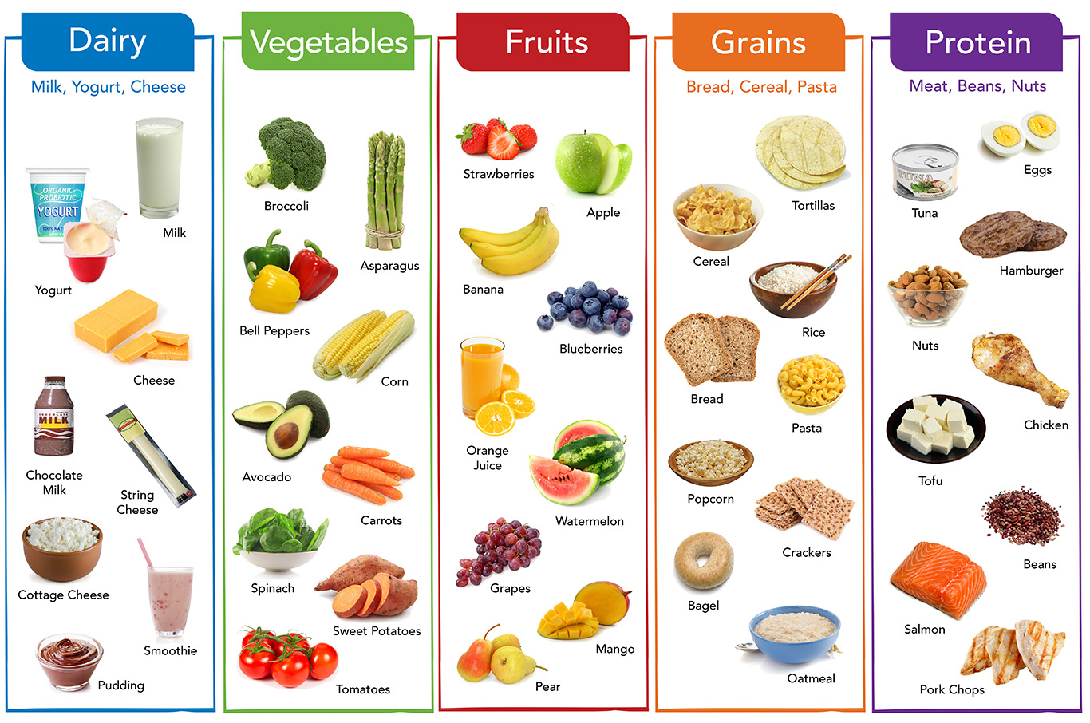
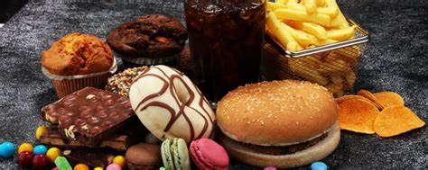
5 Nutrient-Specific Food Groups
Healthy eating pattern
Variety of vegetables Unprocessed fruits Grains Dairy products Variety of protein foods
Fresa
Empty Calories
Toffu
Pudin
Notes:
Alimentos y bebidas de alta densidad nutricional: Son alimentos que proporcionan vitaminas, minerales, proteínas y otros nutrientes y componentes beneficiosos para la salud, con pocas azúcares añadidas, grasas saturadas y sodio.

Slide 8
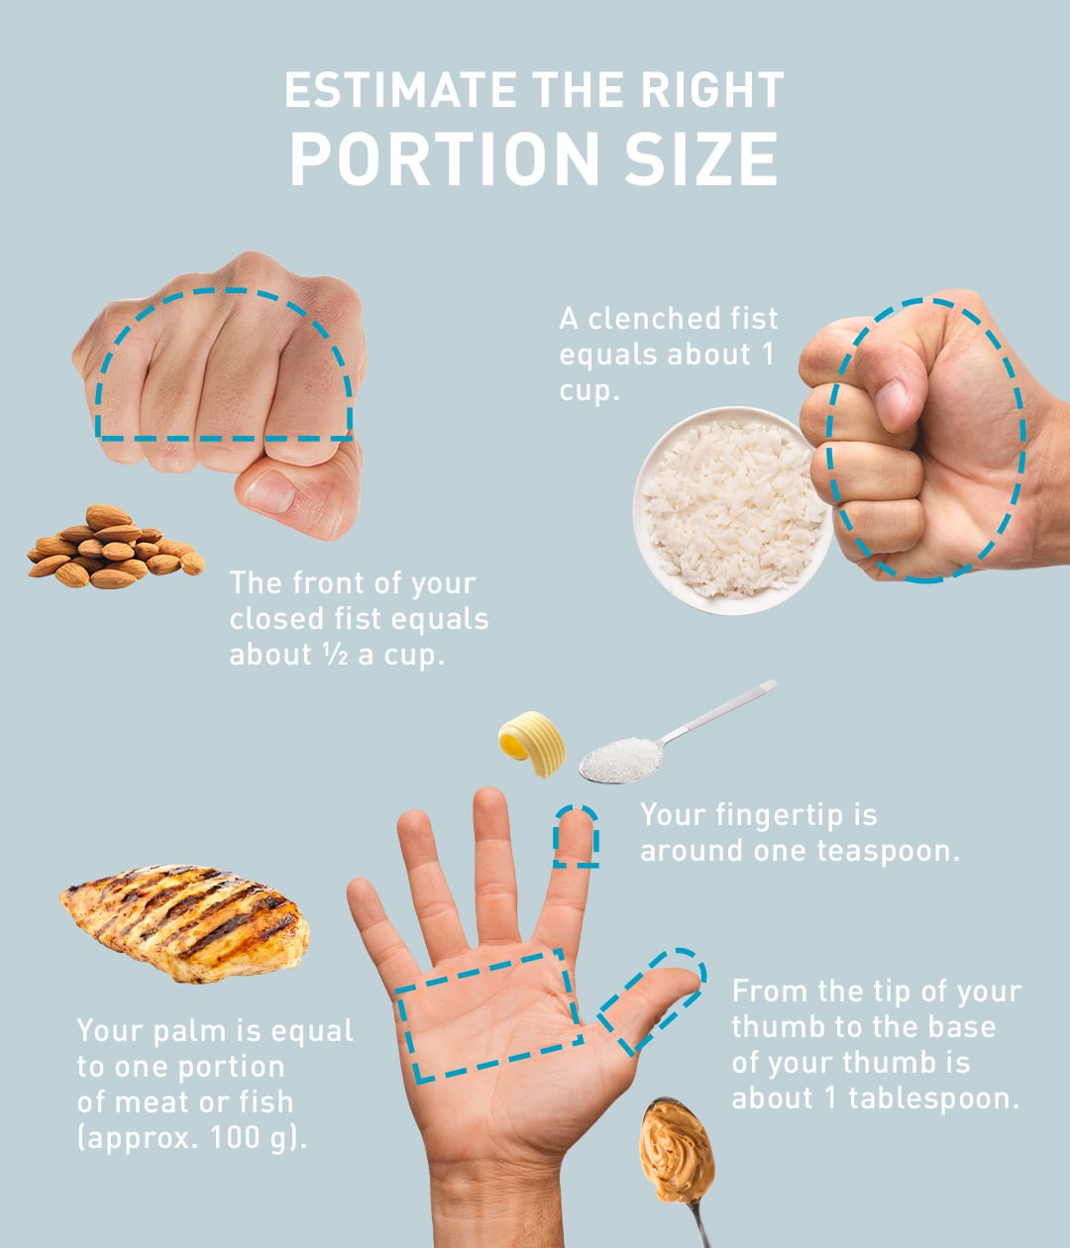
THERE ARE 3 WAYS TO SHOW HOW WE CONTROL PORTIONS:​
​Hand and cups

Slide 9
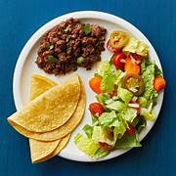
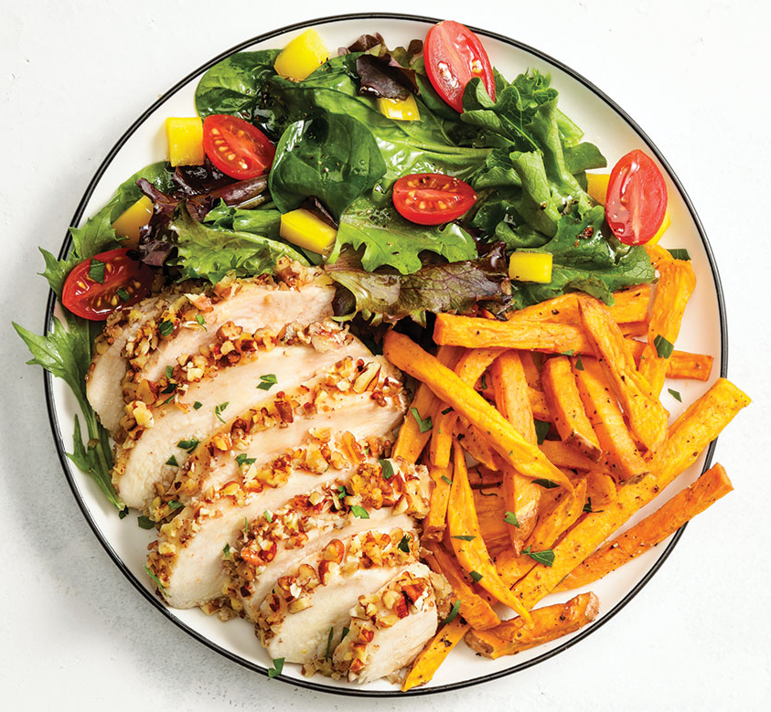
THERE ARE 3 WAYS TO SHOW HOW WE CONTROL PORTIONS:​
2. Following MyPlate recommended portions

Slide 10
Easy Ways to Form Your Plate with the Right Portions
Start with a 9-inch plate.
Fill half of your plate with vegetables and fruits.
Fill a quarter of your plate with lean protein.
Fill the other quarter with whole grains.
Avoid repeating a second plate!
Notes:
Patrón alimentario saludable Seguir un patrón alimentario saludable ayuda a cubrir las necesidades nutricionales, a mantener un peso saludable y reducir el riesgo de enfermedades crónicas. Esto puede beneficiar a todas las personas, independiente de estado actual de salud, su edad, raza u origen étnico. La información provista en esta Guía le ofrece alternativas de alimentos y bebidas de alta densidad nutricional, que pueden adaptarse a sus gustos y preferencias personales, las costumbres y platos tradicionales y al presupuesto disponible. En términos generales, las mujeres necesitan consumir menos calorías que los hombres. Las mujeres entre los 19 y 30 años necesitan consumir entre 1,800 y 2,400 calorías diarias, mientras que los hombres en este mismo grupo de edad requieren entre 2,400 y 3,000 calorías. Entre los 31 y 59 años, las mujeres requieren entre 1,600 y 2,200 calorías diarias y los hombres entre 2,200 y 3,000 calorías. Se observa, entonces, que durante la adultez las necesidades calóricas disminuyen debido a los cambios de metabolismo que acompañan el envejecimiento. Los niveles de actividad física, la composición corporal y la presencia de enfermedades crónicas, entre otros factores, afectan las necesidades calóricas.

Slide 11
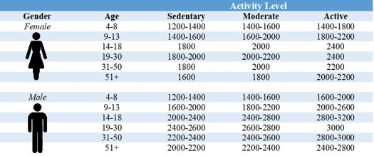
THERE ARE 3 WAYS TO SHOW HOW WE CONTROL PORTIONS:​
3. Counting your individual calorie needs
For an exact value https://www.myplate.gov/es/myplate-plan
For a close approximate use reference table View notes for activity instructions
Depends on:
Your age, your current weight and height, your metabolism, gender, how active you are

Slide 13
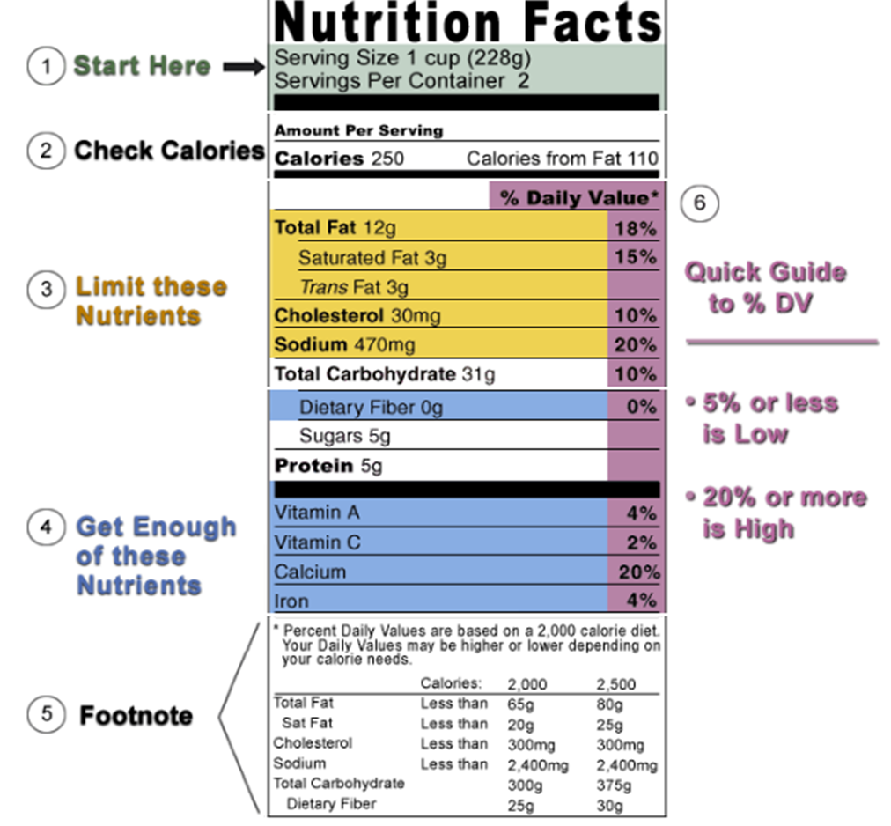
LABELS HELP US IDENTIFY HOW MANY CALORIES PER PORTION
Use Nutrition Facts on Labels as a Tool to Measure Portions of Packaged Foods

Slide 14
What tool will you use to have portion control?
Using hands and cups
MyPlate portions
Counting calories following MyPlate Plan

Slide 15
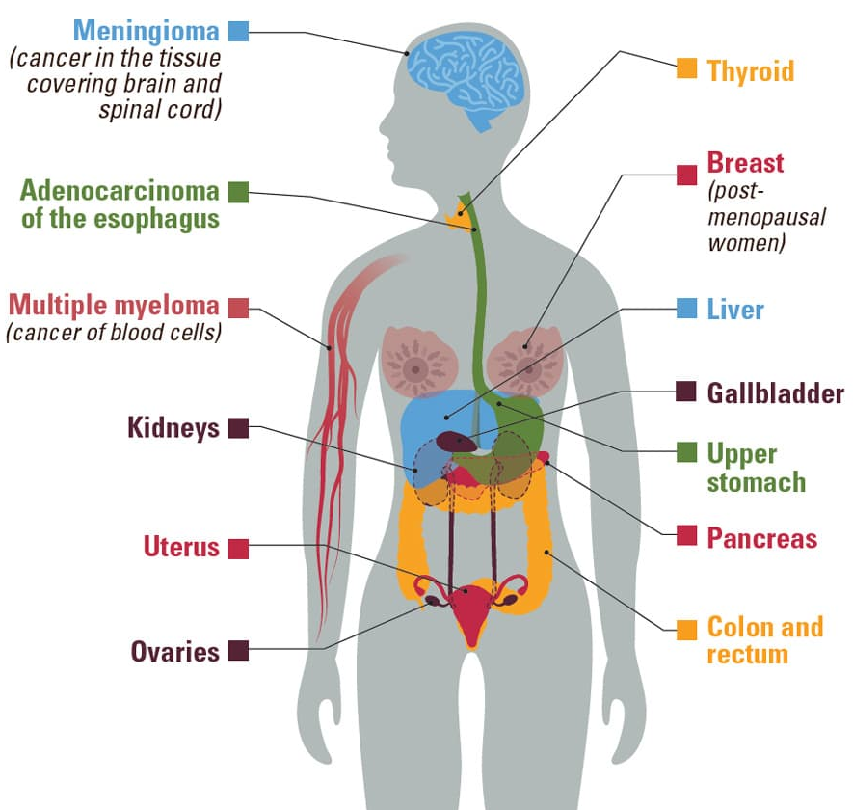
13 Cancers
are
associated
with
Overweight
and Obesity
Notes:
How might obesity increase the risk of cancer?
Several possible mechanisms have been suggested to explain how obesity might increase the risks of some cancers (32, 33).
Fat tissue (also called adipose tissue) produces excess amounts of estrogen, high levels of which have been associated with increased risks of breast, endometrial, ovarian, and some other cancers.
People with obesity often have increased blood levels of insulin and insulin-like growth factor-1 (IGF-1). High levels of insulin, a condition known as hyperinsulinemia, is due to insulin resistance and precedes the development of type 2 diabetes, another known cancer risk factor. High levels of insulin and IGF-1 may promote the development of colon, kidney, prostate, and endometrial cancers (34).
People with obesity often have chronic inflammatory conditions such as gallstones or non-alcoholic fatty liver disease. These conditions can cause oxidative stress, which leads to DNA damage (35) and increases the risk of biliary tract and other cancers (36).
Fat cells produce hormones called adipokines that can stimulate or inhibit cell growth. For example, the level of an adipokine called leptin in the blood increases with increasing body fat, and high levels of leptin can promote aberrant cell proliferation. Another adipokine, adiponectin, is less abundant in people with obesity than in people with a healthy weight and may have antiproliferative effects that protect against tumor growth.
Fat cells may also have direct and indirect effects on other cell growth and metabolic regulators, including mammalian target of rapamycin (mTOR) and AMP-activated protein kinase.

Slide 16
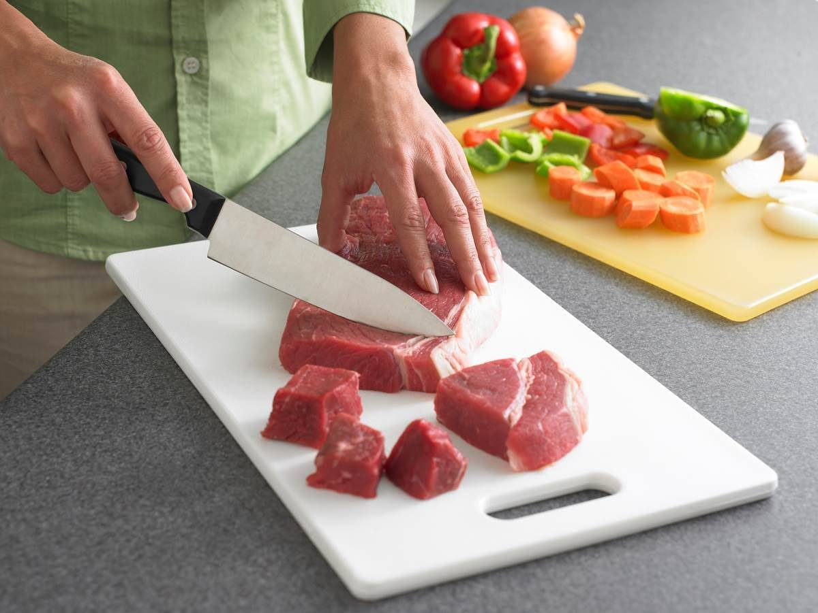
"Portion control means eating small portions"
Notes:
Cocina una cena saludable solo una vez a la semana, ese es un gran primer paso. Trate de cocinar las comidas en lotes el fin de semana para calentar para las cenas durante la semana.

Slide 17
FALSE
Portion control is not about drastically reducing food intake or eating small portions.
It's all about understanding the right portion sizes for your body and adjusting them to your individual needs.
Notes:
Cocina una cena saludable solo una vez a la semana, ese es un gran primer paso. Trate de cocinar las comidas en lotes el fin de semana para calentar para las cenas durante la semana.

Slide 18
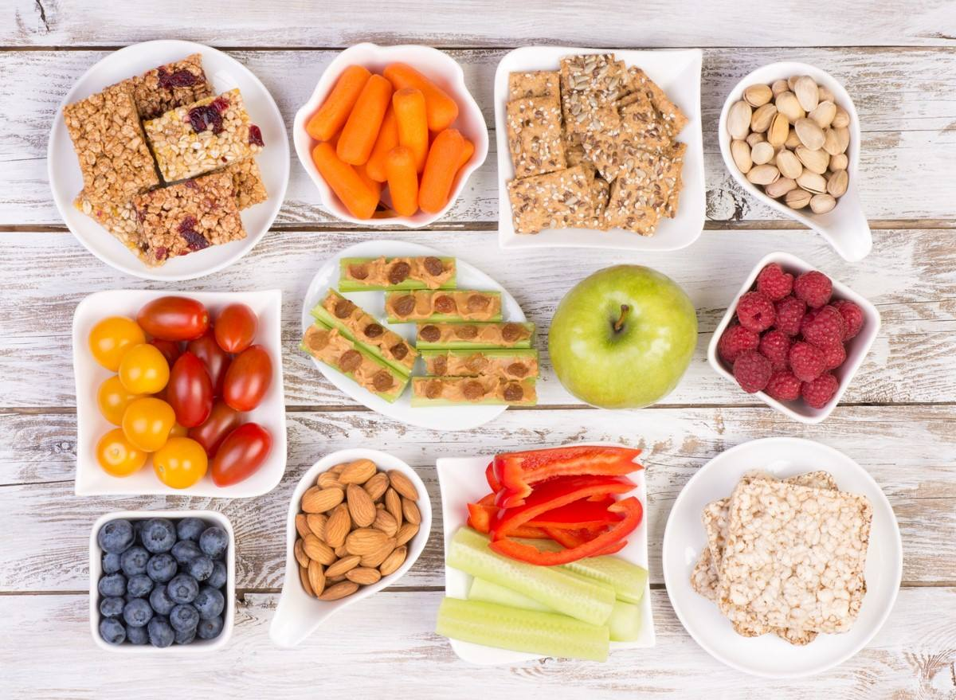
Portion control will limit nutrients and make me hungrier
Notes:
Cocina una cena saludable solo una vez a la semana, ese es un gran primer paso. Trate de cocinar las comidas en lotes el fin de semana para calentar para las cenas durante la semana.

Slide 19
FALSE
Your body doesn't crave calories. Craves nutrients.
If you eat high-calorie, low-nutrient foods (like fast food), your body isn't getting the vitamins and minerals it needs to signal to the brain that it's had enough already. Then you keep eating.
Notes:
Cocina una cena saludable solo una vez a la semana, ese es un gran primer paso. Trate de cocinar las comidas en lotes el fin de semana para calentar para las cenas durante la semana.

Slide 20
What are some challenges in eating appropriate portions?

Slide 21
BARRIERS AND SOLUTIONS
FOR HEALTHY EATING
I can't control when I like something | Try eating slower and enjoy the taste and texture of food. This will help you stay connected with your senses.
I crave everything when I’m at the store | Avoid going hungry on the errand as much as possible because you will have less willpower to buy foods that you do not need and are not healthy.
I don't know how to measure food | It is true that it can be overwhelming not to know the amounts in grams so always use your hands for an approximate measurement of the appropriate amounts.

Slide 22
How will your plate look like now?
Notes:
To get started, we are going to talk about a basic framework, or guidance for eating. By show of hands, who recognizes this image? This is the USDA’s food guidance system for the country and can be used to guide your food choices. The plate represents each of the five food groups which are fruits, vegetables, protein, grains and dairy. The plate shows how each of the five food groups fits into a healthy meal. The concepts represented in this plate are:
1) Proportion: What do you notice about how each food group is represented on the plate? Wait five seconds for responses. The five food 3 groups are represented in different proportions that can be used to guide how you plan what types of foods are in your meals. The recommendation is to make half your plate fruits and vegetables; a little more than a quarter of your plate grains, choosing whole grains at least 50 percent of the time, and less than a quarter of your plate lean protein foods. Dairy foods are a good accompaniment to meals, and low-fat plain dairy foods are recommended for anyone over two years of age.
2) Variety: The meal represented on the plate contains all five food groups. While it may be difficult to eat food from all five groups at each meal, it’s important to include foods from each food group in the meals and snacks you eat throughout the day. Eating a variety of foods every day allows you to get all the nutrients your body needs.
Purpose of Food Groups As nutrition science has progressed over time, scientists have discovered vitamins, minerals, and other components that make up our foods, and surely, there are more yet to be discovered. Food groups simplify dietary recommendations by focusing on foods instead of nutrients. For example, it’s much easier to try to eat two cups of fruit a day than 75 milligrams of vitamin C and 25 grams of fiber. The USDA Food Patterns provide the recommended amounts of each food group and subgroup at 12 different calorie levels, ranging from 1,000 to 3,200. These patterns are developed using food pattern modeling. By eating recommended amounts, individuals can meet their nutritional needs without having to track dozens of individual nutrients.
Food Group Amounts The USDA Food Patterns specify targets for each food group in cup equivalents (for Fruits, Vegetables, and Dairy) and ounce equivalents (for Grains and Protein Foods). Each pattern also includes a limited number of calories (8-19%) that can be used in other ways, such as small amounts of added sugars and saturated fats. Americans are encouraged to choose foods in their most nutrient dense forms as often as possible, to keep added sugars and saturated fat intakes each below 10 percent of total calorie intake.

Slide 23
IMPORTANCE RULER
0
1
2
3
4
5
6
7
8
9
10
Not at all important
Somewhat important
Extremely Important
How important is it for you to consume healthy portions of all food groups?
Notes:
ROLE PLAY
On this scale, with 1 being not at all important to consume more fruits and vegetables, and 5 being very important to consume more fruits and vegetables, which point best reflects how important it is to you to change nutritional habits?
Why did you say a ___ (the number they chose) and not a ___ (high number than given)?
What would it take for you to become a ___ (higher number than given)?
It might need to be done several times before action plan is developed.

Slide 24
Role models! Let's learn about community success stories
Spanish Video-
https://vimeo.com/238992514 https://vimeo.com/899952017 https://vimeo.com/897302369
How can you relate to the story?
How is the story different from your life in terms of barriers you would have to make a change in your diet?
What limitations and motivations do you have to make a change?
Notes:
En que te puedes identificar con la historia ?
En que es diferente la historia a tu vidaen cuanto a barreras que tendrias para hacer un cambio en tu alimentacion?
Que limitaciones y motivaciones tienes para hacer un cambio?

Slide 25
TAKE CONTROL
Focusing on your actions
GOAL
Between TODAY and the next TSSC follow-up, my goal is:[............................................................................].
ACTION PLAN
✓ What you will do
✓ Why ✓ Where you'll do it ✓ When you'll do it ✓ How long you'll do it
What CHALLENGES could I face? How would you overcome them?
Notes:
Reducido: alimentos procesados Al crear su plan de acción, es importante saber lo siguiente: ✓ Qué harás ✓ Dónde lo harás ✓ Cuándo lo harás ✓ Cuánto tiempo lo harás Establecer metas puede ser el primer paso para crear su plan de acción para controlar su presión arterial. Un posible objetivo podría ser medir su presión arterial dos veces al día entre ahora y la próxima cita con su proveedor de atención médica. Para lograr ese objetivo, puede obtener lecturas de la presión arterial una vez por la mañana y una vez por la noche. Al crear sus metas, tenga en cuenta qué desafíos podría enfrentar y cómo los superaría. ¿Cuál podría ser su objetivo personal para controlar su presión arterial?

Slide 26
ACTION PLAN
My GOAL is:_________________________________________________________________
Why will I do it?
How will I do it?
When will I do it?
Challenges I might face?
Ways to meet the challenges?
What benefits will I get?
Notes:
As you fill out your meal plan, think about the following:
Why you want to make healthier changes in your food patterns.
What motivates you to make changes that might not be easy but are worth doing for a better health.
Think about what barriers you may encounter and what solutions you have
Role Play an Example
Add one fruit or vegetable to every meal.
If you get fast food, ask for a salad instead of fries.
Commit to one salt-free day a week. Use herbs for flavor instead.
Keeping cut-up fruits and veggies on hand in the fridge for easy snacking.
Chose healthier takeout and fast-food options, like a grilled chicken sandwich instead of fried.

Slide 27
READY TO CHANGE BEHAVIOR
0
1
2
3
4
5
6
7
8
9
10
Not at all ready
Somewhat ready
Extremely Ready
READINESS RULER
On a scale of 0-10, how ready are you to eat the right portions of all food groups?
Notes:
ROLE PLAY
On this scale, with 1 being not at all important to consume more fruits and vegetables, and 5 being very important to consume more fruits and vegetables, which point best reflects how important it is to you to change nutritional habits?
Why did you say a ___ (the number they chose) and not a ___ (high number than given)?
What would it take for you to become a ___ (higher number than given)?
It might need to be done several times before action plan is developed.

Slide 28
CONFIDENCE TO CHANGE BEHAVIOR
0
1
2
3
4
5
6
7
8
9
10
Not at all confident
Somewhat confident
Extremely confident
CONFIDENCE RULER
On a scale from 0 to 10, how confident are you of making a change that leads you to eat the right portions of all food groups?
Notes:
ROLE PLAY
On this scale, with 1 being not at all important to consume more fruits and vegetables, and 5 being very important to consume more fruits and vegetables, which point best reflects how important it is to you to change nutritional habits?
Why did you say a ___ (the number they chose) and not a ___ (high number than given)?
What would it take for you to become a ___ (higher number than given)?
It might need to be done several times before action plan is developed.

Slide 29
HANDOUTS
Plate for activity
Mi plate-plan Action Plan

Slide 30
REFERENCES
https://www.cdc.gov/spanish/cancer/obesity/index.htm

