Slide 1
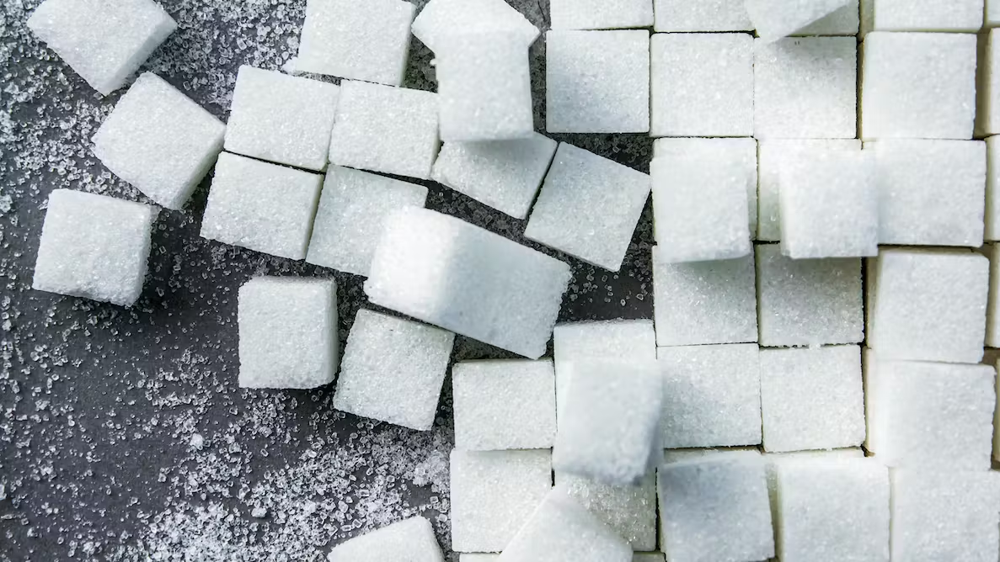
SUGAR
A TSSC Health Coaching Module

Slide 2
Let's talk about how things have been going
since the last time we met
Notes:
PROMOTORA

Slide 3
Let's start with good news!
About 8 out of 10 people are trying to reduce sugar consumption
in their eating pattern ("diet").
Notes:
La informacion tiene poder! Vamos a unirons a este movimiento.
The good news is that the added-sugar message is breaking through, and many American adults crave a change. In fact, research suggests that 77 percent of Americans are striving for less sugar in their diets. And 7 in 10 consumers are willing to give up a favorite sugary product in favor of finding a healthier alternative. The willingness is there. For now, your best defense is education.

Slide 4
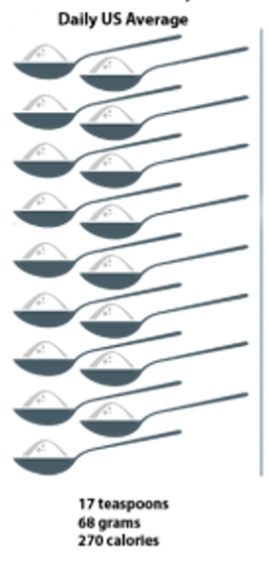
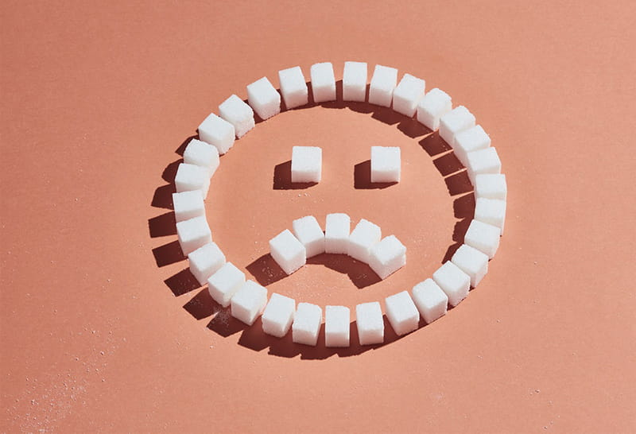
DID YOU KNOW:
Facts about current consumption
American adults consume an average of 17 teaspoons of added sugar every day, more than 2 to 3 times the recommended amount for men and women.
This adds up to about 60 pounds of added sugar consumed annually—that's six 10-pound bags!
Notes:
La informacion tiene poder! Vamos a unirons a este movimiento.

Slide 5
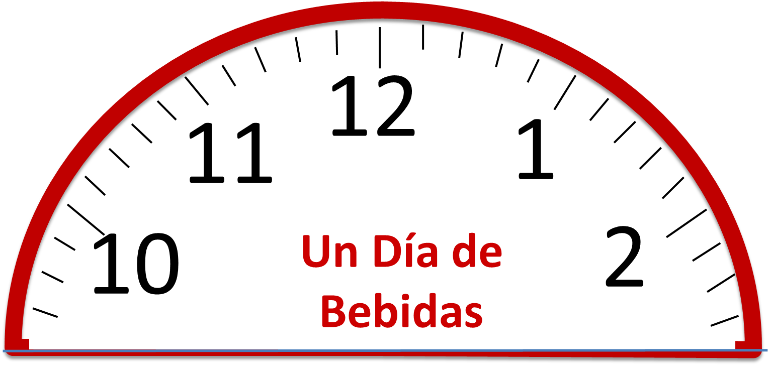
What is your daily beverage consumption?
8 onz.
8 onz.
8 onz.
8 onz.
8 onz.
Use the reference images and think about your usual drinks to get an estimate of the tablespoons per day you consume.
A day of drinks

Slide 6
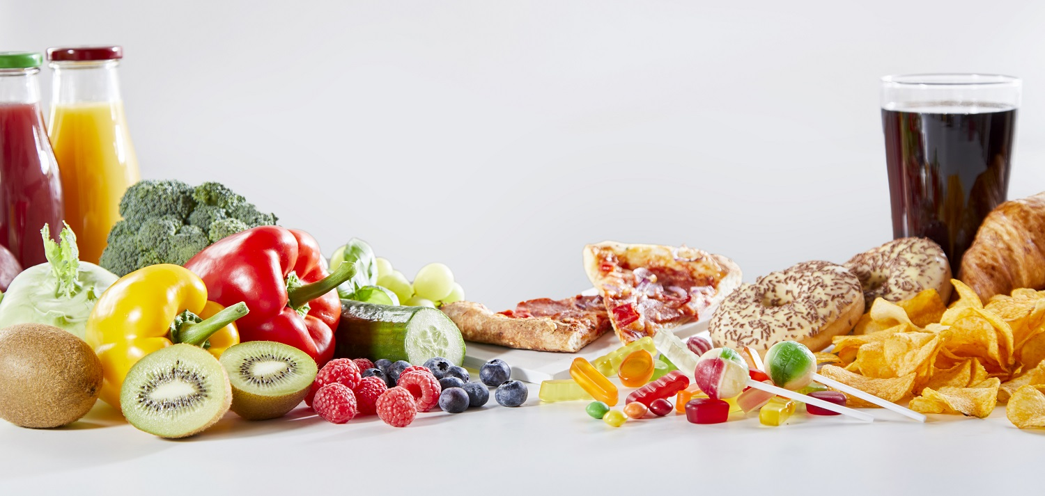
What do you think, is all sugar bad?

Slide 7
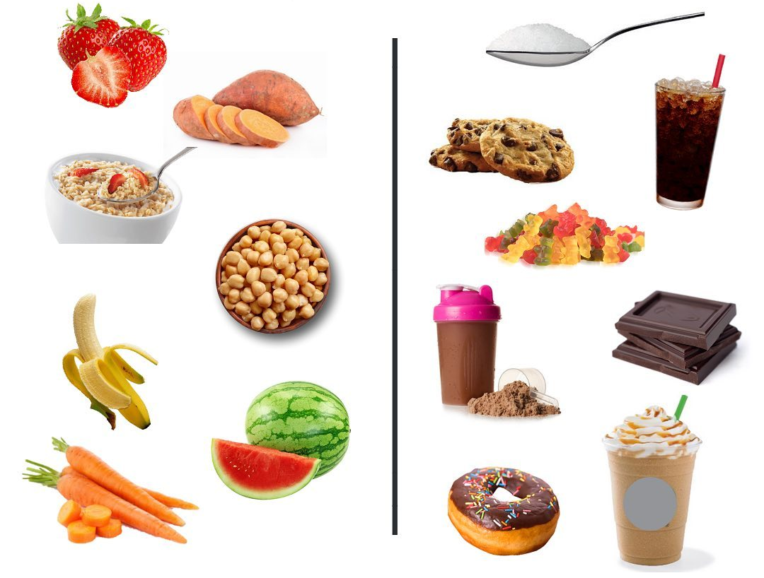
Natural Sugar
Whole, unprocessed foods that naturally contain sugar fall into this category. Fruits, dairy products and even vegetables
contain sugar.
If you only get sugar from these natural sources, you will have enough. Added Sugar
Any sugar added to foods that have
been processed is in this category and should be limited. This includes foods
such as yogurts, candy, cereals, soft
drinks, and cookies.​ Also, any sugar you add to fresh fruit
water and coffee.
Natural Sugar vs. Processed/Added Sugar
Notes:
Sugar is not totally bad, which is important to understand.​
But our modern diets are loaded with more sugar than our body needs.
To understand what is harmful and acceptable when it comes to sugar in food,
we must distinguish between two main types

Slide 8
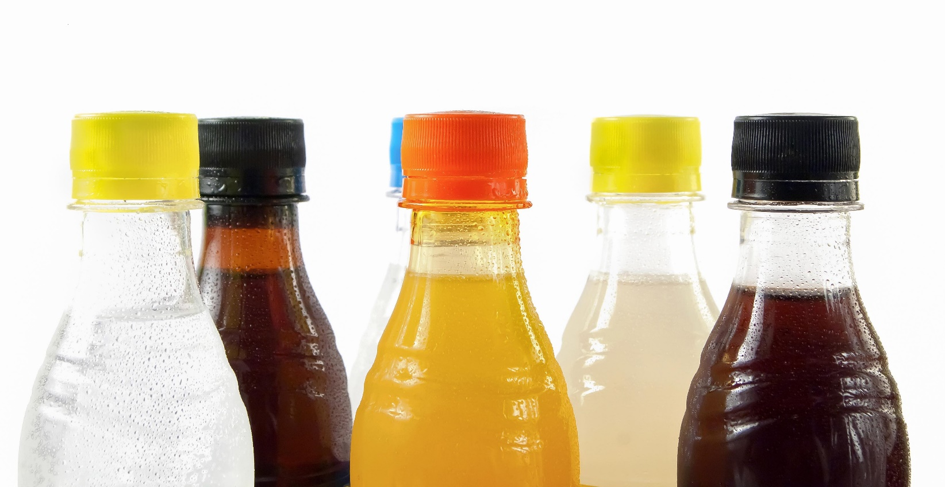
¿What is a sugary drink?
Any drink where sugar has been added:
Regular Soda
Fruit drinks
Fresh water with added sugar
Limonade
Sweetened teas
Energy drinks
Sports drinks
Notes:
Ejemplos de bebidas azucaradas mas comúnmente consumidas:
Sodas o Refrescos (Coca Cola, sodas “de sabor” como ponche, naranja, Sprite, etc)
Kool Aid
Sunny D
Tampico
Capri-Sun
Aguas frescas con azúcar añadida (EJEMPLOS: horchata, Jamaica, tamarindo, etc.)

Slide 9
Added Sugar in Our Diets
Sugary drinks are the leading source of added sugar in Americans' diets!
Sugary drinks
Candies and
pastries
Grains
Mixed dishes
Dairy
Condiments
Fruit
Vegetables
Notes:
Las bebidas azucaradas son la fuente número 1 de azúcares añadidos en las dietas de los Estadounidenses.
En la grafica podemos ver que casi la mitad de toda el azúcar añadida que consumen los Estadounidenses proviene de lo que beben (refrescos o sodas, jugos)
Después de las bebidas, encontramos que la mayoría del azúcar añadida en la dieta proviene de dulces y snacks.
¿Qué nota usted en la gráfica acerca de las Frutas y Vegetales?
Solo una pequeña cantidad de azúcar añadida proviene de las frutas y vegetales. ¡Una razón mas para consumir más frutas y vegetales!
DATA SOURCE: What We Eat in America (WWEIA) Food Category analyses for the 2015 Dietary Guidelines Advisory Committee. Estimates based on day 1 dietary recalls from WWEIA, NHANES 2009-2010.
https://health.gov/dietaryguidelines/2015/guidelines/chapter-2/a-closer-look-at-current-intakes-and-recommended-shifts/#figure-2-10-desc-toggle
Beverages are the leading category source of added sugars (47% of all added sugars):
soft drinks – 25%
fruit drinks – 11%
sport/energy drinks – 3%
coffee/tea – 7%
And, as you might guess, snacks and sweets are the next biggest contributor of added sugars at 31%.

Slide 10
Read before drinking!
Common Sweeteners
High Fructose Corn Syrup
Malta
Cane
Caramel
Juice
Honey
Molasses
Agave Nectar
Other Words for Sugar
Fructose (natural, in fruits)
Lactose (natural, in milk)
Sacarose
Maltose
Glucose
Dextrose
Notes:
Entonces, ¿qué vamos a hacer para reducir la cantidad de azúcar que consumimos?
Es muy importante revisar la etiqueta de nutrición:
El azúcar se presenta en distintas formas. El azúcar natural que se encuentran en las frutas se llama FRUCTOSA. El azúcar natural de la leche y los productos lácteos se llama LACTOSA.
Las comidas y bebidas con azucares naturales le dan al cuerpo otros nutrientes que son necesarios para estar sanos. Pero por el contrario, el azúcar añadida en las bebidas azucaradas solo aporta calorías y poco o nada de nutrientes.
Lea los ingredientes en la etiqueta de nutrición y revise el nivel de azúcar añadida. Los ingredientes se enlistan en un orden de acuerdo al de mayor contenido en el producto. Es decir, el ingrediente que se enlista primero, es el de mayor cantidad. Si el azúcar se enlista en primer lugar, significara que ese producto tiene mucha azúcar.
Los nombres mas comunes para el azúcar añadida se enlistan en la diapositiva.

Slide 11
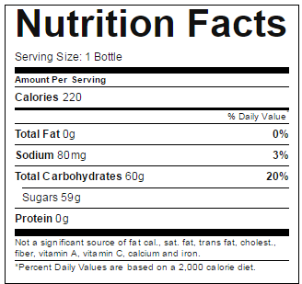
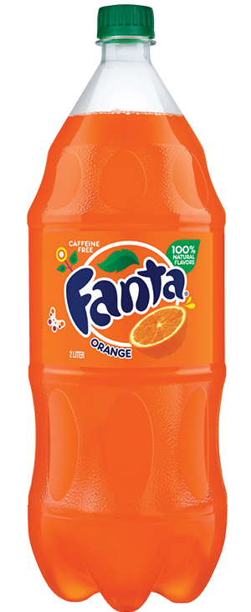
Check the food labels!
59 grams in just one soda!​ The recommendations are no more than 36 grams for men and 25 grams per day for women and children over 2 years old.
Bottle of 16 onz
Orange Soda
Notes:
Revise la etiqueta de nutrición. Si una de las palabras para el azúcar está en los primeros 3 ingredientes, es una bebida azucarada.
¿Qué puede observar en la lista de ingredientes que pudiera ser azúcar?
Grams to tablespoons 3 level teaspoons make up 1 tablespoon.
10 grams = 0.782 tablespoons
20 grams = 1.56 tablespoons
30 grams = 2.34 tablespoons
40 grams = 3.12 tablespoons
50 grams = 3.91 tablespoons
60 grams = 4.00 tablespoons
70 grams = 4.67 tablespoons
80 grams = 5.33 tablespoons
90 grams = 6.34 tablespoons
100 grams = 7.82 tablespoons
125 grams = 8.45 tablespoons
(Source: We Can! Parent handbook, choosemyplate.gov)

Slide 12
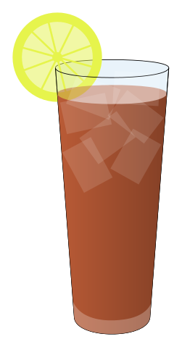
Liquid Calories
Regular Soda
(20 onz)
240 calories
65 g sugar
Fruit Juice
(16 onz)
200 calories
47 g sugar
Café mocha
(16 onz)
300 calories
35 g sugar
Orange Juice
(8 onz)
110 calories
21 g sugar
Sweetened Iced
(16 onz)
150 calories
36 g sugar
12
11
1
A day of drinks
1000 Calories
204 g sugar
10
2
Notes:
¡Las calorías y el azúcar en las bebidas realmente importan!
Si lo recuerdan, cuando queremos perder peso, tenemos que tener en cuenta las calorías que consumimos (en los alimentos y en las bebidas) y las que quemamos (a través de la actividad física.
A menudo no pensamos en las calorías que consumimos de las bebidas. Pero las bebidas azucaradas pueden agregar muchas calorías, y además, la gente todavía suele comer la misma cantidad de alimentos. Esto se debe a que los líquidos no satisfacen el hambre de la misma manera que los alimentos.
En esta diapositiva podemos ver que todas las bebidas juntas suman 1,150 calorías y 204 gramos de azúcar.
Esta es una gran parte de la razón por la que beber bebidas azucaradas puede conducir al aumento de peso.
Un ejemplo: Una botella de 20 onzas de jugo, bebida energética o de refresco, contiene 250 calorías y 16 cucharaditas de azúcar.
Le tomara 50 minutos de correr o caminar 5 millas para poder quemas esas calorías.
Picture adapted from: http://articles.extension.org/pages/19894/a-day-of-beverages-make-good-choices
(From findings published online in the American Journal of Public Health)

Slide 13
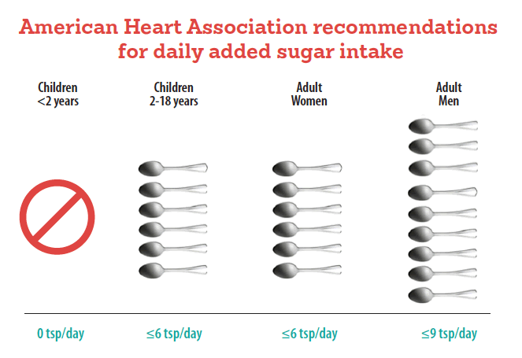
Recommendations

Slide 14
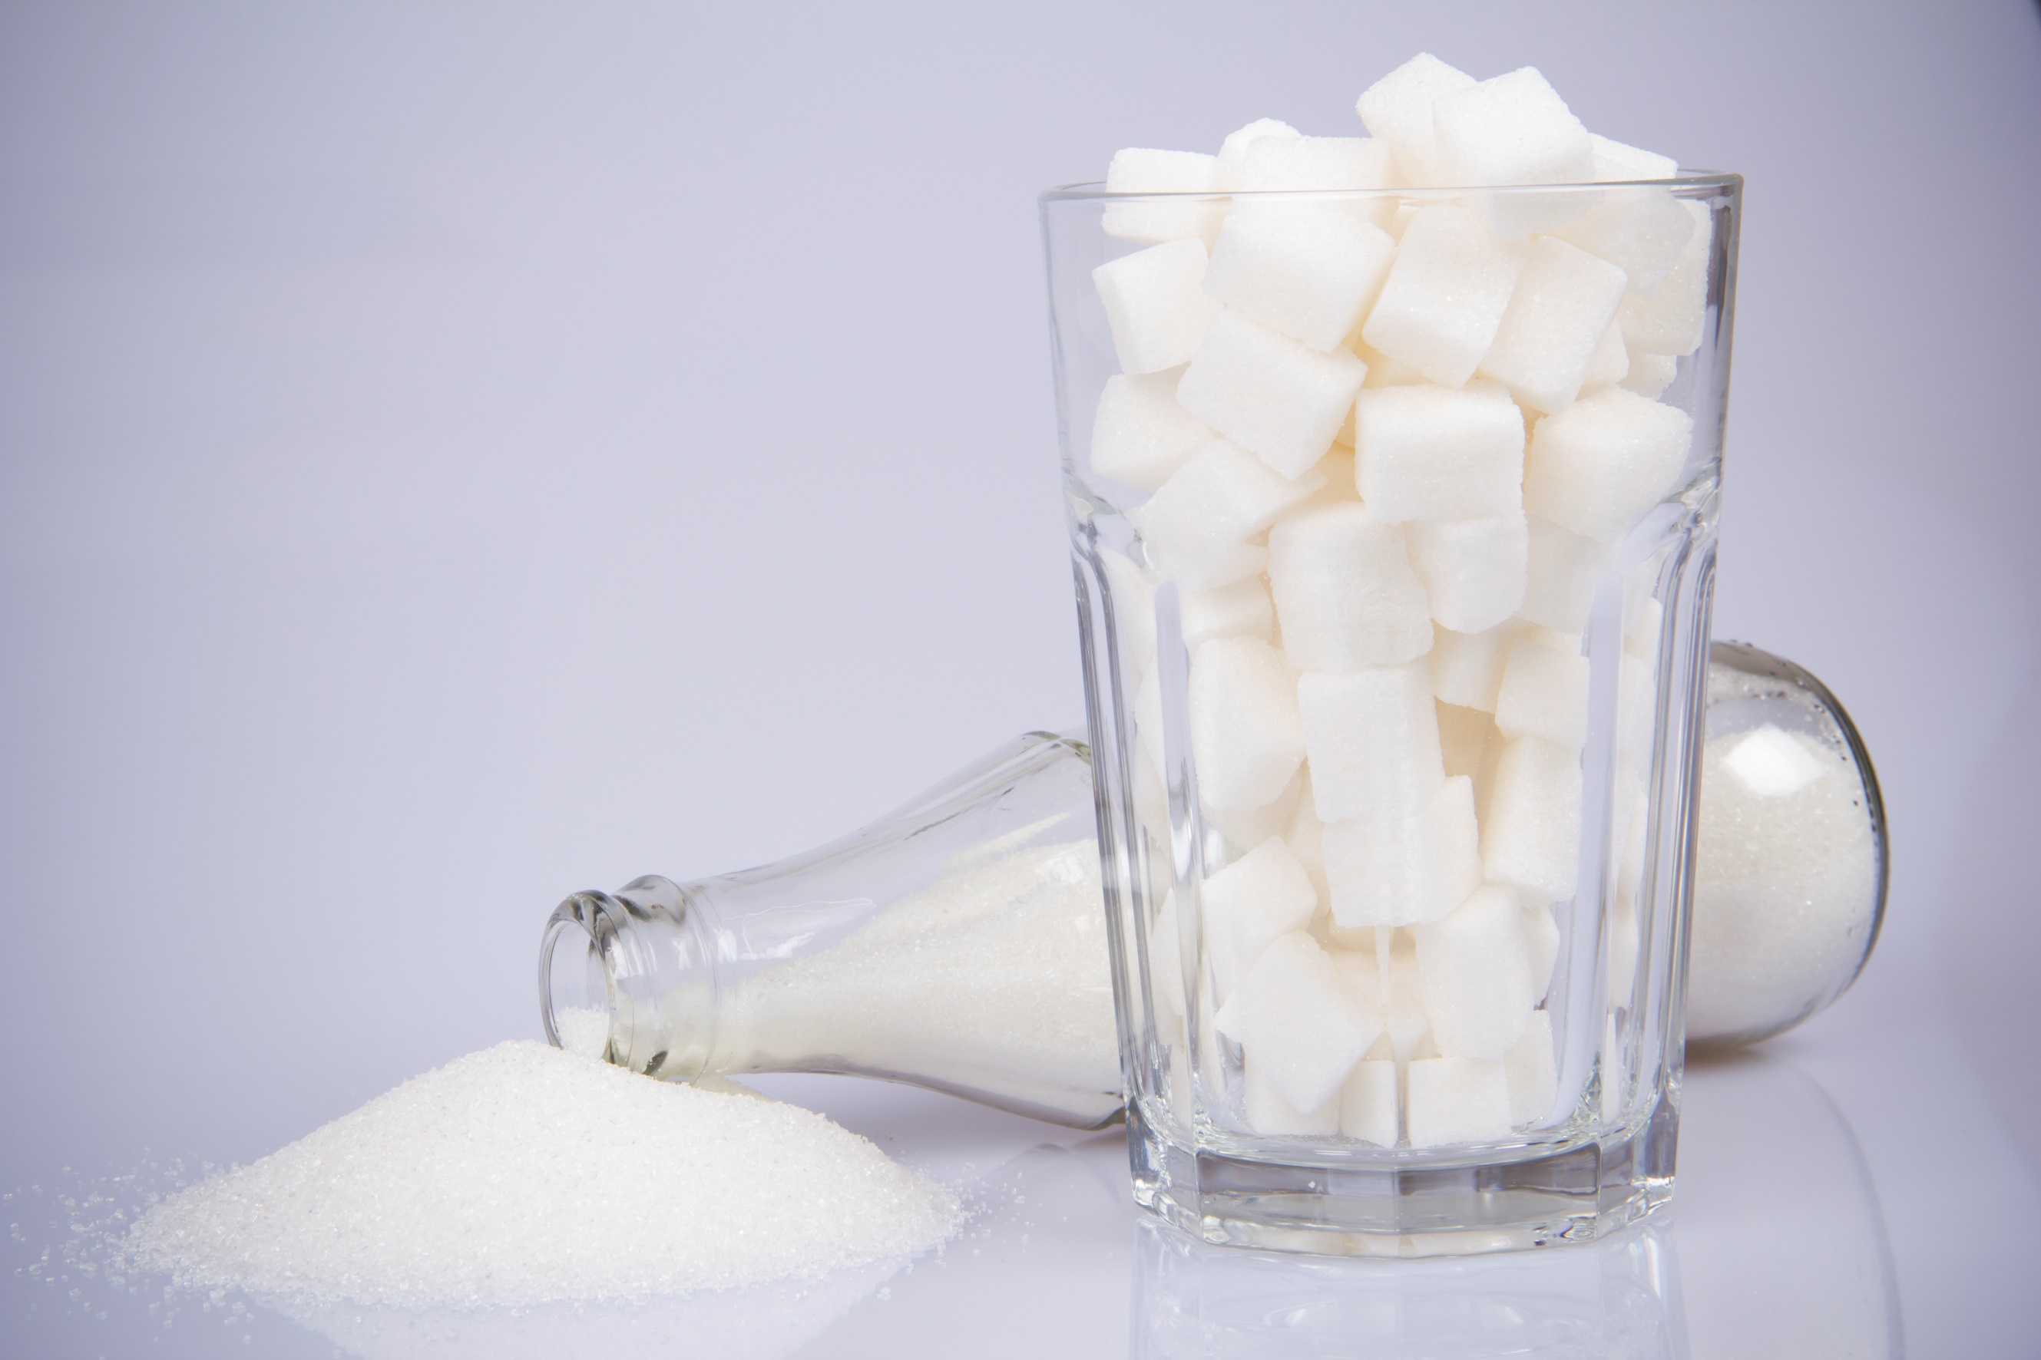
¿HOW SWEET IS IT?
Activity
Notes:
ACTIVIDAD DE AZUCAR
[REVISE LA HOJA "LÍMITES DE BEBIDAS AZUCARADAS" EN LAS PÁGINAS DE RECURSOS CON LOS PARTICIPANTES]

Slide 15
Health Effects

Slide 16
What is the Issue?
Most people consume more sugar than they think
Added sugar provides calories but no nutrients
Too much sugar can cause weight gain, type 2 diabetes, heart disease, hypertension and tooth decay
Notes:
¿Cuál es el problema con el azúcar?
El azúcar con moderación está bien para la mayoría de las personas. Pero, el problema es que también hay azúcar escondido en muchos tipos diferentes de alimentos y bebidas, por lo que la mayoría de la gente consume más azúcar de lo que cree.
Por ejemplo, las galletas, pan dulce y pasteles son comidas donde es obvio que vamos a encontrar el azúcar. Pero hay comidas como el pan blanco, las salsas, comidas congeladas, o frutas enlatadas, donde encontramos una alta cantidad de azúcar también y no sabemos.
Las comidas bajas en grasas o “light”, pueden tener un alto contenido de azúcar para mejorar su sabor.
Siempre revise las etiquetas de nutrición para estar seguro de la cantidad de azúcar en esos productos.
El azúcar agregado en las comidas, va a agregar calorías pero no nutrientes.
Comer demasiada azúcar puede agregar muchas calorías adicionales a su dieta, quitándole el lugar a los alimentos saludables y nutritivos.
Cuando usted consume demasiada azúcar en su dieta regular, se puede provocar el aumento de peso, enfermedades como la diabetes tipo 2, enfermedad cardíaca y caries dentales.
Disminuir el consumo de azúcares agregados, especialmente de bebidas endulzadas como sodas y jugos de frutas, puede ayudarlo a usted y a su familia a mantener un peso saludable.

Slide 17
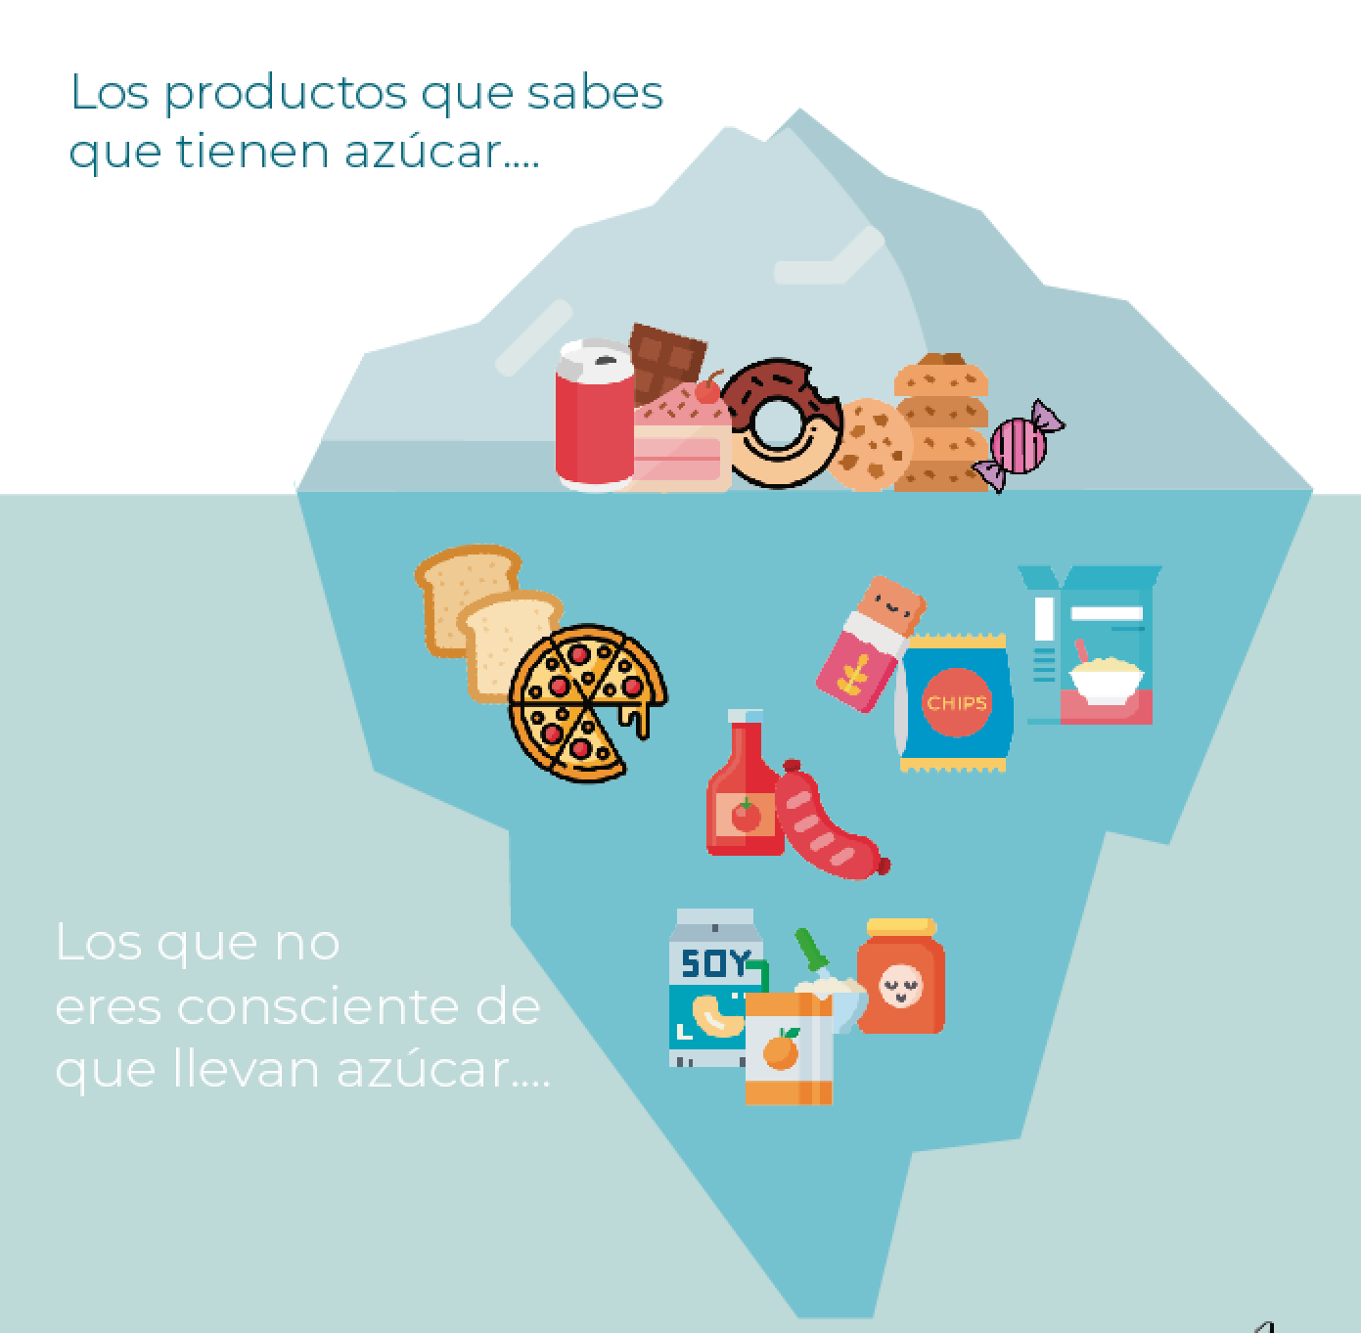
“If a food is not sweet, it can't have much sugar”
Foods you know they contain sugar
Foods you are unaware they also contain sugar
Notes:
¿Qué opina de esto? ¿Qué piensa usted? ¿lo ha escuchado antes?

Slide 18
Foods you know they contain sugar
FALSE!
Sugar is found in many different types of foods hta may not taste sweet such as breads, salad dressings, frozen foods and more.
Check the nutrition label to be sure!
Foods you are unaware they also contain sugar
Notes:
¿Qué opina de esto? ¿Qué piensa usted? ¿lo ha escuchado antes?

Slide 19
“Fruit-flavored drinks like Kool Aid, Sunny D, Tampico, and Capri-Sun are healthy.”
Notes:
¿Qué opina de esto? ¿Qué piensa usted? ¿lo ha escuchado antes?

Slide 20
FALSE!
Fruit-flavored drinks that are not 100% juice have little or no real fruit juice in them. Many are mainly sugar and added with water and contain almost as many calories as soft drinks.
Notes:
¿Qué opina de esto? ¿Qué piensa usted? ¿lo ha escuchado antes?

Slide 21
Barriers | Solutions
I don’t know how to get started | Be aware of the foods and drinks with sugar that you are currently consuming and know the risks of consuming sugar
I really like carbonated soft drinks | Get used to less sugar little by little by drinking mineral water with a splash of juice or fruit
It makes me want to eat cookies and muffins throughout the day. | Plan your day ahead of time. Cut vegetables and carry them with you all day to avoid the temptation of eating cookies.

Slide 22
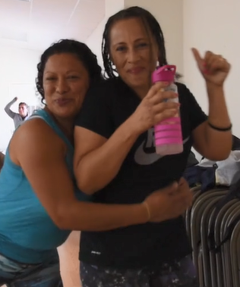
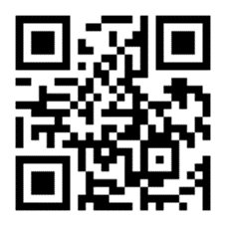
ROLE MODEL VIDEO
Spanish, group of women –
https://vimeo.com/231416485
English, group of women –
https://vimeo.com/239726331
QUESTIONS TO DISCUSS What do you think of this video?​​ What did you think of what the ladies in this video recommend?​​
Notes:
Spanish, group of women -- https://vimeo.com/231416485
English, group of women -- https://vimeo.com/239726331

Slide 23
HOW IMPORTANT IS SUGAR CONSUMPTION FOR ME?
0
1
2
3
4
5
6
7
8
9
10
Not at all important
Somewhat important
Somewhat importante
IMPORTANCE RULER
¿How important is this topic for you?
Notes:
ROLE PLAY
On this scale, with 1 being not at all important to consume more fruits and vegetables, and 5 being very important to consume more fruits and vegetables, which point best reflects how important it is to you to change nutritional habits?
Why did you say a ___ (the number they chose) and not a ___ (high number than given)?
What would it take for you to become a ___ (higher number than given)?
It might need to be done several times before action plan is developed.

Slide 24
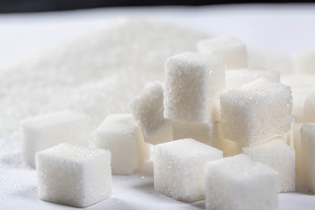
TAKE CONTROL
By focusing on your actions
GOAL
Between now and my next appointment, my goal is to:[............................................................................].
ACTION PLAN
✓ What you will do
✓ Why ✓ Where you will do it ✓ When you will do it ✓ How long you will do it
What challenges might you face? How would you overcome them?
Notes:
Reducido: alimentos procesados Al crear su plan de acción, es importante saber lo siguiente: ✓ Qué harás ✓ Dónde lo harás ✓ Cuándo lo harás ✓ Cuánto tiempo lo harás Establecer metas puede ser el primer paso para crear su plan de acción para controlar su presión arterial. Un posible objetivo podría ser medir su presión arterial dos veces al día entre ahora y la próxima cita con su proveedor de atención médica. Para lograr ese objetivo, puede obtener lecturas de la presión arterial una vez por la mañana y una vez por la noche. Al crear sus metas, tenga en cuenta qué desafíos podría enfrentar y cómo los superaría. ¿Cuál podría ser su objetivo personal para controlar su presión arterial?

Slide 25
ACTION PLAN
My GOAL is:_______________________________________________________________________________________________
Why will I do it?
How will I do it?
When will I do it?
Challenges I might face?
Ways to meet the challenges?
What benefits will I get?
Notes:
As you fill out your meal plan, think about the following:
Why you want to make healthier changes in your food patterns.
What motivates you to make changes that might not be easy but are worth doing for a better health.
Think about what barriers you may encounter and what solutions you have
Role Play an Example
Add one fruit or vegetable to every meal.
If you get fast food, ask for a salad instead of fries.
Commit to one salt-free day a week. Use herbs for flavor instead.
Keeping cut-up fruits and veggies on hand in the fridge for easy snacking.
Chose healthier takeout and fast-food options, like a grilled chicken sandwich instead of fried.

Slide 26
HOW READY ARE YOU TO MAKE A CHANGE
0
1
2
3
4
5
6
7
8
9
10
Not Ready
Somewhat Ready
Ready
READINESS RULER
On a scale from 0-10, ¿how ready do you feel about reducing your sugar consumption?
Notes:
ROLE PLAY
On this scale, with 1 being not at all important to consume more fruits and vegetables, and 5 being very important to consume more fruits and vegetables, which point best reflects how important it is to you to change nutritional habits?
Why did you say a ___ (the number they chose) and not a ___ (high number than given)?
What would it take for you to become a ___ (higher number than given)?
It might need to be done several times before action plan is developed.

Slide 27
CONFIDENT TO MAKE A CHANGE
0
1
2
3
4
5
6
7
8
9
10
Not confident
Somewhat confident
Extremely confident
CONFICENCE RULER
On a scale from 1-10, ¿how CONFIDENT do you feel about reducing your sugar consumption?
Notes:
ROLE PLAY
On this scale, with 1 being not at all important to consume more fruits and vegetables, and 5 being very important to consume more fruits and vegetables, which point best reflects how important it is to you to change nutritional habits?
Why did you say a ___ (the number they chose) and not a ___ (high number than given)?
What would it take for you to become a ___ (higher number than given)?
It might need to be done several times before action plan is developed.

Slide 28
HANDOUTS
Action Plan

Slide 29
REFERENCES
National Heart, Lung, and Blood Institute
Ways to Enhance Children’s Activity and Nutrition (We Can!) (https://www.nhlbi.nih.gov/health/educational/wecan/)
American Heart Association
http://www.heart.org/en/healthy-living/healthy-eating/eat-smart/sugar/added-sugars
Harvard University, The Nutrition Source
https://www.hsph.harvard.edu/nutritionsource/healthy-drinks/sugary-drinks/
Sugary Drink Facts
http://sugarydrinkfacts.org/nutrition_facts.aspx
Coordinated Approach to Child Health (CATCH)
https://catchinfo.org/
Centers for Disease Control and Prevention
https://www.cdc.gov/healthyweight/healthy_eating/drinks.html

