Slide 1
Active Children Have Active Minds
Improving Achievement Test Scores Using PASS & CATCH
Nancy G. Murray, Dr.PH
Michael & Susan Dell Center for
Advancement of Healthy Living
The University of Texas
School of Public Health
Research Into Action – A Knowledge
Translation Initiative

Slide 2
What’s This All About?
Being active stimulates the mind,
helping everyone function better
throughout the day. Teachers have
known for years that students are
more attentive, less fidgety, behave
better, and can improve scholastically
after physical activity. So why not build movement and exercise into the educational curriculum?
PASS & CATCH is an easy, inexpensive way to make physical exercise an integral part of the integral part of the learning process.

Slide 3
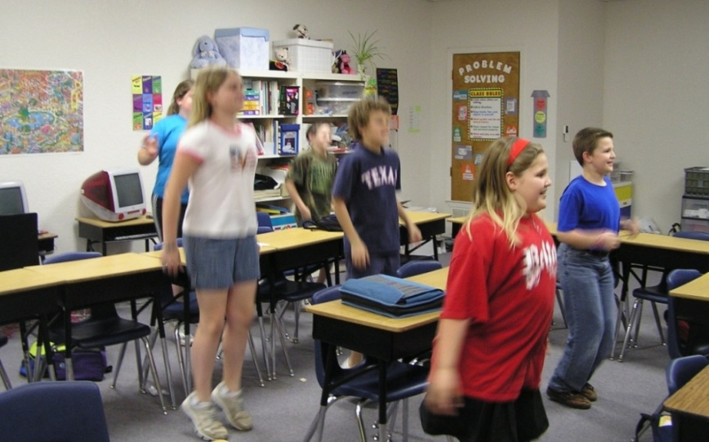
What Is PASS & CATCH?
Physical Activity and Student Success
Coordinated Approach To Child Health
PASS & CATCH gets children’s
hearts pumping as much as their minds. The goal is to have
students participate in
moderate to vigorous physical
activity for about an hour per school day, including recess
and physical education class, by using exercise as a learning
tool in the classroom. It doesn’t take the place of learning –
it’s learning in a new way.

Slide 4
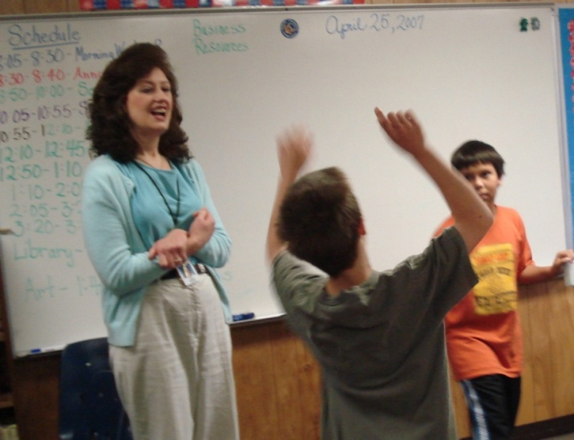
Types of Activities
Zero In (10 minutes, grades 3-5, from Take 10!®)
Students try to help a classmate guess a “secret number” on the board behind him/her. The class will either perform vertical jumps if the student needs to guess higher, or squats if the student needs to guess lower.
Invisible Jump Rope (10 minutes,
grades 3-5, from Take 10!®)
Students recall basic counting,
addition, and subtraction while
jumping an invisible rope. The teacher calls out a number, and everyone jumps as they count up to it.
All activities taken from Take 10!®

Slide 5
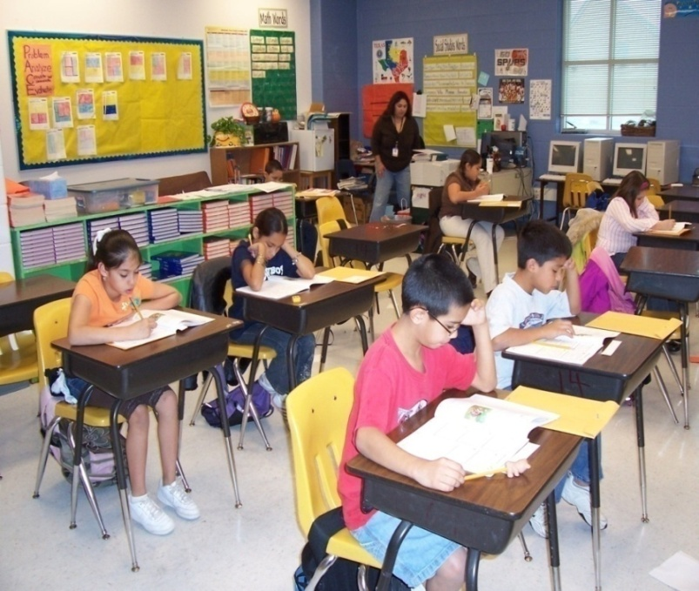
What Are the Benefits?
                All PASS & CATCH students showed significant increases in math scores over time.
                Low-performing children who were exposed to physical activity in the classroom caught up in math scores with students in non-PASS & CATCH schools within one year.
When classroom physical activity and recess are added to physical education for 60 minutes a day, elementary school children achieve higher test scores in math – even those identified as adapting poorly to school – and significantly improve their reading scores.

Slide 6
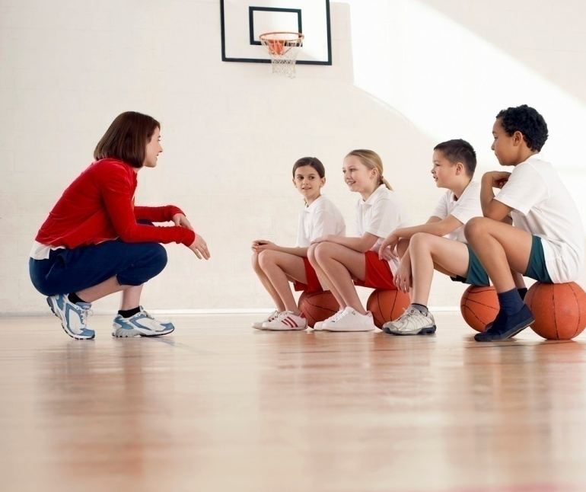

I’m Interested … Now What?
Visit www.catchinfo.org to learn
more about how active kids have
active minds …
… and www.take10.net to learn how to incorporate physical activity into the curriculum.

Slide 7

Nancy G. Murray, Dr.PH
Michael & Susan Dell Center for
Advancement of Healthy Living
The University of Texas School of Public Health
Nancy.G.Murray@uth.tmc.edu
with assistance from
and

